Slide 1
Probabilistic planning
Workshop
Dimitar Bakardzhiev
Notes:
Agile teams commonly apply 'yesterday's weather' to estimate delivery dates and required resources.
Unfortunately, the overall success of this approach is mediocre, at best. Can we do better? Yes, we can!
In this hands-on workshop you will learn how adopting a probabilistic framework allows teams to apply more reliable forecasting techniques for better outcomes. In short, Probabilistic Forecasting uses historical data from the actual delivery history of a project team and combines it with probabilistic techniques & Monte Carlo simulations to greatly enhance the reliability of your team's forecasts.

Slide 2
All material in this document is a copyright of Modern Management Institute, and is being distributed only to attendees of our training events.
Recipients of this document are NOT permitted to redistribute this material or to use it for other training class or workshop – with or without change. It is also not permitted to use parts of this presentation or slides in your own training material, presentations or publications without our express written consent.
It takes many years of hard work, sustained investment of time & money to create expertise. Please help respect that expertise and prevent IP and copyright infringements. Together we can make a difference.

Slide 3
Training Objectives
The goals of forecasting, how probabilistic planning works and why you need it
What data should be captured and how it can be used
How to answer the three biggest forecasting questions:
How Big – determining how big is the feature or project with less effort
How Long – determining how long it would take to deliver a project or feature
How Much – determining what will fit into a fixed delivery time (e.g. sprint, release, quarter)
How to use Continuous forecasting to see as early as possible if the reality is going in the same direction as our forecast.

Slide 4
Agenda
Probabilistic project sizing using Randomized Branch Sampling (RBS)
Forecasting project delivery time using Reference Class Forecasting (RCF)
Forecasting number of developers needed for a project
Managing and tracking of project performance using a Project Buffer

Slide 5
Equipment
A white board, a flipchart and markers. Participants should carry their laptops with MS Excel installed.

Slide 6
What do you want out of this? Your Goals & Questions…
Note at least 3 things that you want to take away or 3 questions you want answers for
Hold me accountable. Make sure you have gotten what you wanted and/or have had your questions answered by the end of this day.

Slide 7
Introductions
Who we are and why we’re here.

Slide 8
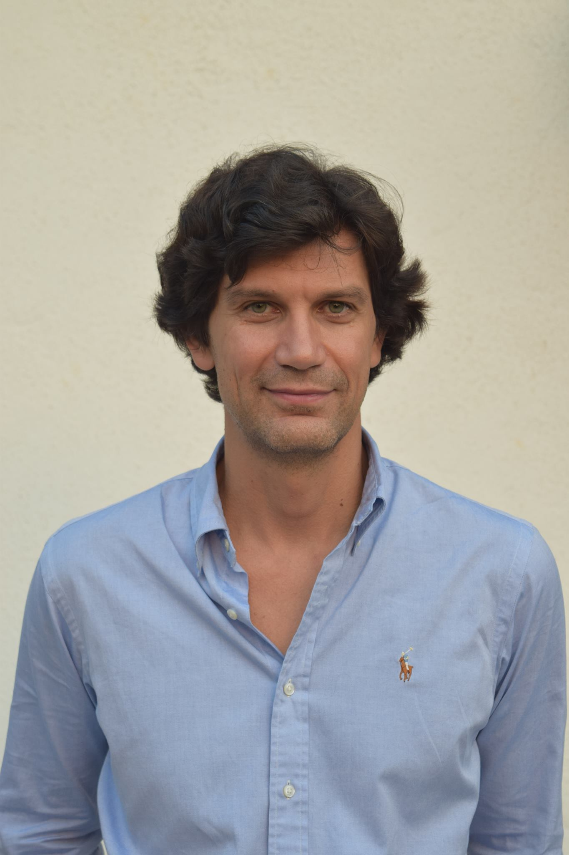
Dimitar Bakardzhiev is an expert in managing successful and cost-effective technology development. With his blend of technical, managerial and operational expertise, he effectively combines the theory and practice of Agile and Kanban Method to deliver business results.
Accredited Kanban Consultant (AKC),
Expert Kanban practitioner,
Brickell Key Award 2015 Finalist,
Published in Bulgarian - David Anderson’s Kanban book as well as books on Lean, Theory of Constraints and Deming's Theory of Management.
@dimiterbak

Slide 9

More on the topic at
http://www.infoq.com/author/Dimitar-Bakardzhiev
#NoEstimates Project Planning Using Monte Carlo Simulation
Probabilistic Project Sizing Using Randomized Branch Sampling (RBS)
Probabilistic Project Planning Using Little’s Law

Slide 10
Introductions
Hello
My Name is…..
Notes:
Introduce your training facilitator
Please write your Name & Role on the Name Tag;
Please let us know your current roles; Who are here -
capability managers,
directors,
vice presidents,
heads of departments or
senior executives
Others

Slide 11
Forecasting Self-Assessment
How do you rate yourself?
Novice
Curious, No previous knowledge or information, “was asked to attend”
Informed
Have watched videos, Have read some web sites and/or articles
Apprentice
Read one or more books, some months practical experience
Practitioner
Good practical experience
Master
I can be teaching this class ☺ (Yes, we are glad to leverage your expertise).
From Meilr Page-Jones Maturity Model
Notes:
Traditional ways vs Kanban way

Slide 12
Why forecast, Aren’t we Agile?

Slide 13
“The greatest loss of time is delay and expectation, which depend upon the future. We let go the present, which we have in our power, and look forward to that which depends upon chance, and so relinquish a certainty for an uncertainty.” Lucius Annaeus Seneca

Slide 14
Clients come to us with an idea for a new product and they always ask the questions - how long will it take and how much will it cost us to deliver? They need a delivery date and a budget estimate.
Notes:
Customers come to us with a new product idea and they always ask the questions - how long will it take and how much will it cost us to deliver?

Slide 15
Reality is uncertain, yet we as software developers are expected to deliver new products with certainty.
Notes:
Reality is uncertain, yet we as software developers are expected to deliver new products with certainty.

Slide 16
Deterministic planning used these days forces certainty on uncertain situations and masks the uncertainty instead of highlighting it.
Notes:
Deterministic planning used these days forces certainty on uncertain situations and masks the uncertainty instead of highlighting it. It calculates the project-specific costs based on a detailed study of the resources required to accomplish each activity of work contained in the project’s work breakdown structure or in other words, taking an “inside view” on the project being estimated. For high-level planning, deterministic estimation of all work items is wasteful of people’s time and infers precision when it isn’t present.
The techniques presented here are fast and for most of the projects they will produce more accurate results.

Slide 17
To increase the chances of project success we need to incorporate the uncertainty in our planning and exploit it.

Slide 18
If we have a lot of uncertainty now, we don’t need much data to reduce uncertainty significantly. When we already have a lot of certainty, then we need a lot of data to reduce uncertainty significantly.
Notes:
Often we have to live with merely reducing our uncertainty.
It is often assumed that if you have a lot of uncertainty you need a lot of data to reduce it.
In fact just the opposite is true.
Additional uncertainty reduction becomes more and more expensive as we approach an uncertainty of zero.
In the case of random sampling out of some infinite population, our sample size would have to approach infinity to fully eliminate uncertainty.
However, the uncertainty tends to fall away relatively quickly with the first few observations. Each additional decrease in uncertainty usually takes more effort than previous decrease in uncertainty.
If we have a lot of uncertainty now, you don’t need much data to reduce uncertainty significantly.
When we already have al lot of certainty, then we need a lot of data.
The early part of any measurement usually is the high value part.
Don’t attempt a massive study to measure something if you have a lot of uncertainty about it now.
Measure a little bit, remove some uncertainty and evaluate what you have learned.
Iterative measurement gives you the most flexibility and the best bang for the buck.
----
In the context of decision analysis, the word “expected” always means “probability weighted average”.
ß

Slide 19
Probabilistic forecasting reduces uncertainty about decisions that have economic consequences.
Notes:
Information reduces uncertainty about decisions that have economic consequences.
In business the reasons we measure something are at least partially related to how the measurement affects management decisions.
If we are uncertain about a business decision that means we have a chance of making the wrong decision. “Wrong” means that there was an alternative decision which have turned …
The cost of being wrong id the difference between the “wrong” decision we took and the alternative we would have chosen if we had perfect information.
For example if we have to decide should we bid for a new project. In order to do that we need to know if the new project is small enough to fit in our portfolio of projects.
The existence of this risk and the desire to reduce it is the reason the decision maker needs a way to measure the new project. Here we are dealing with a special case of measurement – the forecast. The forecast is a measurement of likely future outcomes (D. Hubbard) If there is no chance that the new project would not fit into our portfolio, there would be no need whatsoever to reduce uncertainty about it – the decision would be risk-free and obvious.

Slide 20
‘You can’t stop the waves, but you can learn to surf’ is a famous saying by Jon Kabat-Zinn
Notes:
Jon Kabat-Zinn is the founder of Mindfulness-Bases Stress reduction program and the person who adopted teachings of Buddhist monks to western clinical approach stress, pain, and many other symptoms.

Slide 21
We can’t control the Waves of Uncertainty, but we can learn How to Surf!
Notes:
We can’t control the Waves of Uncertainty, but we can learn How to Surf!
We do that by planning using reference class forecasting which promises more accuracy in forecasts by taking an "outside view" on the project being forecasted based on knowledge about actual performance in a reference class of comparable projects.

Slide 22
High-level probabilistic planning

Slide 23
High-level probabilistic planning
The initial budget and the range of the time frame
Does not include detailed project plans
The plan is created with the appropriate buffers
Schedules are the execution of the high-level plan
Keep focus on the project intent
Notes:
Probabilistic high-level plan forecasts the initial budget and also the range of the time frame for a project. We don’t plan in detail what is not absolutely necessary to plan. The short-term details, like the scheduling, are done based on the immediate needs and capabilities – and we create these schedules upon the execution of the higher level plan. When executing the high-level plan we have to keep focus on the project intent but we can never be certain which paths will offer the best chances of realizing it. We exploit uncertainty by making a series of small choices which open up further options then observe the effects of our actions and exploit unexpected successes.

Slide 24
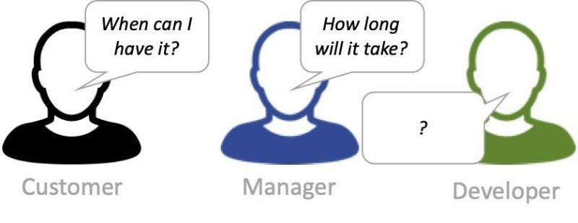
Perspectives: When vs. How long?

Slide 25
Types of forecasting
When ONE work item will be ready?
When a BATCH of work items will be ready? How big? How much?
When we will be able to start a new project?

Slide 26
Probabilistic planning comprises
High level probabilistic forecast (planning phase)
Continuous planning during execution

Slide 27
Continuous planning
Address special causes of variation
Scheduling (complexity and stochastically informed)
Buffer management
Continuous forecasting

Slide 28
Forecasting

Slide 29
Forecasts present most likely futures, based on assumed drivers for change. They feature a limited range of variation and are based on a given set of drivers. Because of their projective nature, forecasts rely on historical data in combination with conjectures of future development.
Notes:
An advantage of forecasting methods and at the same time their drawback is that
they tend to treat the future as a form of continuation of the past. This can be an advantage to a
study, for example in identifying long-lived impact of present decisions; or comparing early-action
and late-action strategies; or exposing overly optimistic expectations of technology development.
Conversely, taking the past as a guide to the future means a drawback as it hides the inherent
uncertainty of the future, especially with regard to disruptive changes

Slide 30
Backcasting

Slide 31
The essence of backcasting is to build bridges from the present to a desirable future in a retrospective manner, while identifying the intermediate steps that lead to that future.
Notes:
Backcasting emphasizes both the articulation of a societal and environmental vision, and the
identification and analyses of pathways to this vision. It aims to connect a vision for the future to
present-day decision making, putting the finger on key choices that have to be made now and in
the near future. In addition, backcasting can be a powerful tool in the interaction with
stakeholders as well – again, to connect vision with concrete near-term priorities for action and
responsibilities. The problems that backcasting has to address are characterised by complex,
interrelated environmental, economic and social challenges, that call for a holistic vision involving
a whole-systems change.

Slide 32
Backcasting Steps
Forecast the probable future
Begin with the end with mind (vision) informed by the forecasting
Look backwards from the vision to the present
Plan step by step towards the vision

Slide 33
Cumulative
delivered
2
T_{plan}
T_{forecast}
1
Vision
3
Forecast
30
Backcasting
25
Throughput
Forecasted
Throughput Plan
20
15
4
Plan
10
5
0
20
30
T (days)

Slide 34
The relationship between forecasting & backcasting

Slide 35
Hoshin Kanri – a Backcasting method

Slide 36
Hoshin Kanri
A step-by-step planning, implementation and review process.
A proven technique that helps organizations focus efforts and achieve results. Originated in the 1960s (Bridgestone Company)
A systems approach to the management of change in critical business processes.
Hoshin = Policy, Principle, Direction
Kanri = Supervision, Administration, Management
Policy = Goal (Objective) + Strategies (Means)
Control Cycle: PDCA Cycle

Slide 37
Why use Hoshin Kanri?
To ensure that insight and vision are not forgotten and ignored as soon as planning activities are over.
To guarantee planning documents, once finalized, are kept alive and acted on daily.
To prevent the daily quota of fire-fighting, unplanned ‘strategic’ meetings, and quarterly bottom-line pressures taking precedence over the really strategic plans
To have short-term activities determined and managed by the plans themselves.
To ensure a continual process of checking to make sure what is done each day reflects the intentions, the targets and the vision of the company has agreed to pursue.
To have both a planning and deployment process to guide and focus the organization.

Slide 38
Glossary
A goal is a broad primary outcome.
A strategy is the approach we take to achieve a goal.
An objective is a measurable step we take to achieve a strategy.
A tactic is a tool we use in pursuing an objective associated with a strategy.
The X Matrix helps us get alignment on the goals, strategies, tactics and measures needed to fulfill our mission/aim.

Slide 39
10,000 feet View
Strategic Management
Hoshin Kanri
A
P
C
D
Mission
Vision
Values
Bus. Models
Industries
Countries
Markets
Customers
Structure(s)
Systems
Partners
M&A
Products
Services
Priorities
Long-Term Plan
Mid-Term Plan
Policy 1
Strategy 1
Objective
Strategy 2
Team
Strategy 3
Policy 2
Strategy 1
Objective
Strategy 2
Strategy 3
Action Plans, Execution,
Results, & Reviews
A
P
C
D
Daily Management & Small Group Activities (7 Basic QC Tools)

Slide 40
Anatomy of a Policy
Policy
=
Objective
+
Strategies
or
Goal
+
Strategies
or
End
+
Means
or
Effect
+
Causes
or
What
+
How
or
What (& Why)
+
How
Notes:
How to establish a Strategy? Ask “What prevents us to achieving the Goal?” The answer is our Strategy.

Slide 41
Basic Policy Template
Goal/Objective
Strategy 1
Leader
Strategy 1 Tactics
Review Results
Leader
Business Case
Strategy 2
Leader
Strategy 2 Tactics
Review Results
Data
Strategy 3
Leader
Strategy 3 Tactics
Review Results

Slide 42
Hoshin Kanri assumes that any suggestions are opinions to be explored and challenged, with the possibility that they may turn out to be wrong, and making it acceptable for people to change their mind.
Notes:
Hoshin Kanri means a shift from organizations operating on the basis that senior management knows best, and tells employees what to do without thinking or asking questions, to one where they propose direction and ask for feedback and enquiry. Instead of assuming that they know the right answers as a facts, Strategy Deployment assumes that any suggestions are opinions to be explored and challenged, with the possibility that they may turn out to be wrong, and making it acceptable for people to change their mind.

Slide 43
How Hochin Kanri planning scales?
Catchball
X-Matrix
Notes:
What leadership proposes, therefore, is strategy, using it as a form of enabling constraint to guide and open up possibilities of what could be achieved. This is as opposed to defining tactics as a form of governing constraint, dictating action and closing down any alternatives that could be explored. A useful metaphor here is the one used by Dave Snowden of types of skeleton. An enabling constraint is like an endo-skeleton (e.g. humans) – formed on the inside, maintaining coherence and allowing growth. A governing constraint is like an exoskeleton (e.g. crabs) – formed on the outside, protecting and limiting growth.
By being clear on strategy, and allowing and encouraging the whole organization to use their skills, knowledge and experience to discover appropriate tactics, it is possible to enable autonomy while maintaining alignment. In this light, all the various Agile practices are simply tactics (and very good ones) to help organizations achieve greater agility as a strategic goal.

Slide 44
Hoshin Kanri: “What How”
Policy
Leadership Team
Goal/Objective
What?
+
Strategies
How?
Department
Goal/Objective
What?
+
Strategies
How?
Section
Goal/Objective
What?
+
Strategies
How?
Team
Goal/Objective
What?
+
Strategies
How?

Slide 45
Hoshin Kanri: “What How” Example
Policy
Leadership Team
Cut Total costs
+
Cut IT costs
IT Department
Cut IT costs
+
Deliver more for the same cost
Technical Capability
Deliver more for the same cost
+
Reduce Lead time
Team
Reduce Lead time
+
Limit WIP

Slide 46
Limiting WIP is a strategy. A WIP limit is a tactic.

Slide 47
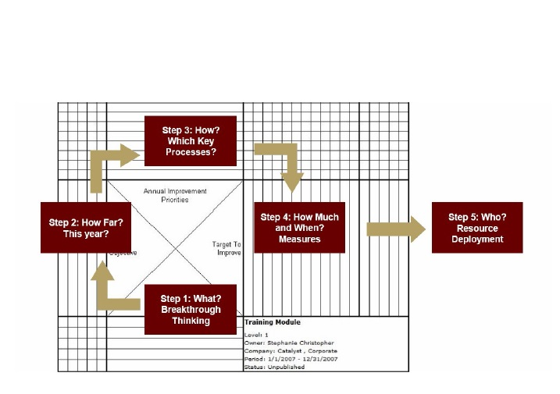
X Matrix
The Hoshin Planning X Matrix
X Matrix
X Matrix Labels
Theme
Goals/Objectives
2). Strategies
3) Supporting Actions/Tactics
4) Actionable Measures / Indicators of Success
5) Resources
Step 3: How? Tactics
Step 2: How? Strategies
Step 4: How Much & When? Measures/Indicators
Step 5: Who?
Resource Deployment
Step 1: What? Goals/Objectives
Strategic Plan Owner:
Date:
Notes:
The X Matrix helps us get alignment on the goals, strategies, tactics and measures needs to fulfill our mission/aim.
The point is to have a solid, linked relationship between
- How things are now.
- What you want them to be.
- What actions are being taken to close the gap.
- Which actions you predict to have what effect (so you can evaluate whether they are working or not).

Slide 48
Objective/Strategy Matrix
Strategy
1
Strategy
2
Strategy
3
Strategy
4
Goal 1
Goal 2
Goal 3
= Strong correlation
= Moderate correlation
= Weak correlation
Blank = No Relationship

Slide 49
Accountability Matrix
Person
1
Person
2
Person
3
Person
4
Tactic 1
Tactic 2
Tactic 3
(or 1) = Team leader
(or 2) = Full-time participation
(or 3) = Not full-time participation
Blank = No Relationship

Slide 50
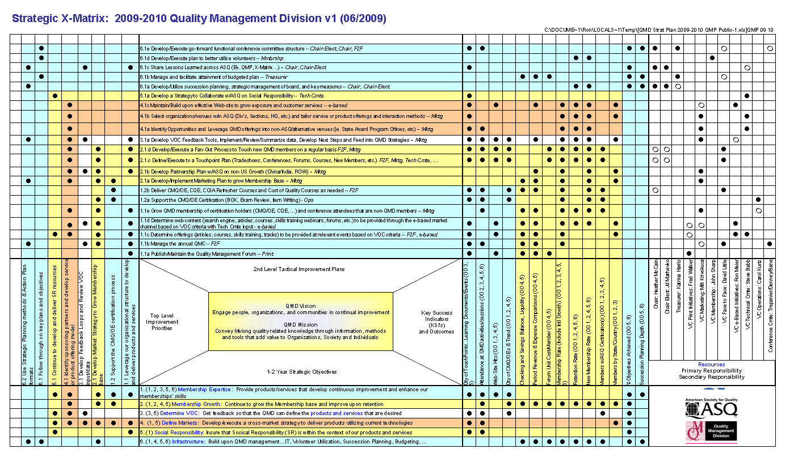
X Matrix Example

Slide 51
Summary
The Hoshin Kanri process has been validated over the last 40 years.
This process is applicable to small and large organizations alike.
It is an effective alignment tool to translate strategies into actions.

Slide 52
Understanding Variability

Slide 53
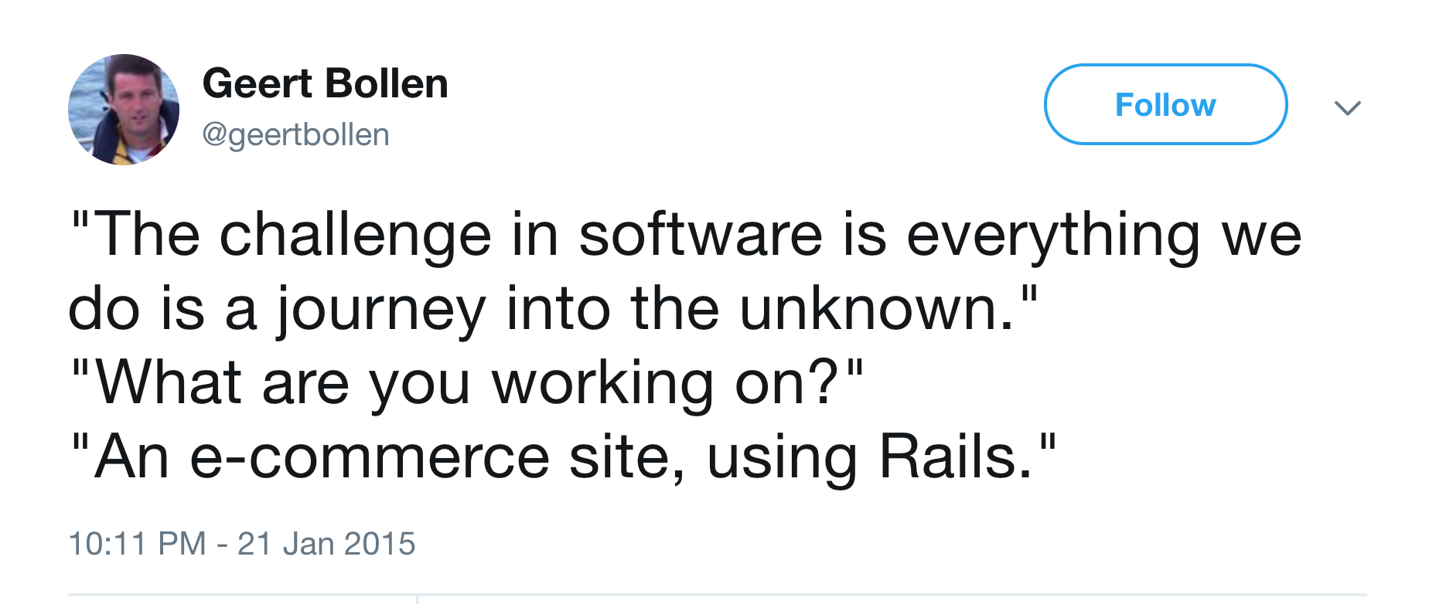

Slide 54
Software development is some dark art that makes predictability impossible? Wrong!

Slide 55
Some software problems are truly complex, but plenty have patterns. Unpredictability is also a system characteristic, not only a domain characteristic.

Slide 56
W. Edwards Deming

Slide 57
The System Of Profound Knowledge® (SoPK)
Appreciation for a system
Knowledge of variation
Theory of knowledge
Psychology

Slide 58
Knowledge of variation
Variation exists and has always existed regardless of business or industry, between people, in output, in service and in product.
Use “understand and manage variation” as a guiding principle.
Think with an understanding of variation.
Without even analyzing the data this way of thinking changes how you think about data and process results.

Slide 59
Common cause and special cause variation
Common cause variations are the natural result of the system. In a stable system, common cause variation will be predictable within certain limits.
Special cause variations represent a unique event that is outside the system.

Slide 60
For example, consider how long it takes you to drive to work assuming your process for doing so is the same from day to day. Suppose, on average, it takes 20 minutes to get to work. It doesn't take, however, 20 minutes each day. Suppose you know that, in general, it will take between 15 minutes and 25 minutes to get to work. Some days it may take 22 minutes; other days 18 minutes; others 24 minutes, etc. The difference between each day's time and the average, most of the time, will not be alarming to you. You realize that the differences are due to the traffic, speed you drive, etc. All these common causes produce common cause variation. It is the normal variation in your process of getting to work.

Slide 61
Common cause variation is part of the system or process. To decrease common cause variation, you must change the system. This is management's responsibility.

Slide 62
Dr. Deming estimated 94% of cases were common cause variation, and he increased his estimate as time went by.

Slide 63
A stable system, one that is in statistical control, has a definable identity and a definable capability. Its behavior in the near future is predictable.

Slide 64
A stable process is one with no indication of a special cause of variation.

Slide 65
Distinguishing the difference between variation, as well as understanding its causes and predicting behavior, is key to management’s ability to properly remove problems or barriers in the system.

Slide 66
Unfortunately our default mode (as people – relating to our psychology, one of the four areas of Deming’s SoPK) is to use special cause thinking.

Slide 67
We try to discover what was special and unique about a specific case (often seeking the person to blame) and fix that. This can work, it is just a very inefficient way to improve predictability.

Slide 68
In the 94% or 97% of cases when common cause thinking would be more efficient we would get better results if we used that thinking.

Slide 69
Tying to the area of psychology; people think there is much less variation than actually exists. Therefore their natural inclination (without a sufficient knowledge of variation) is to suspect a special problem when actually it is just the natural variation in the system.

Slide 70
When the result is within the expected result for the system to use special cause thinking is tampering.

Slide 71
Tampering results in lots of effort with little benefit. Without knowledge of variation superstition can flourish.

Slide 72
Managing a system means managing the system’s common cause variation.

Slide 73
The control chart is a tool to determine if the system is in control (the system gives predictable results) and what those predictable results are. Essentially though the control chart is a tool to help you learn and analyze.

Slide 74
In Kanban we use the Lead time scatter plot as our control chart.

Slide 75
10:00 minutes
Coffee Break
Come Back in 10 Minutes

Slide 76
Lead time
Metrics

Slide 77
Lead time data provides us insight into our service delivery capability.

Slide 78
How we measure Lead Time?
Notes:
For the Project System we measure Customer Lead Time defined as the time interval between Request Accepted and Delivery to the Customer.
For the Dev System we don’t measure the time between Commitment point and first Infinite Queue!
We measure Lead time defined as the time interval between Commitment point and Delivery to the Customer.
And that is for a reason because Project System and Dev System share the same output which is Delivery to the Customer!

Slide 79
It demonstrates the variability of lead times for work items that are moving through our process. This diagram allows us to monitor changes in variability, look for outliers, and drill down into specific cards to investigate root causes.

Slide 80
Kanban system Lead time scaterplot

Slide 81
Across the X-axis is a timeline of the underlying process. The Y-axis represents the Lead time from our data in days. Plotting a dot for every work item completed for the reporting period generates the scatterplot. We do that by finding the date at which the work item was completed and plot a dot on the chart according to its Lead Time. If there are several work items that finish on the same day with the same Lead Time then we simply plot several dots on top of one another.

Slide 82
What we are looking for are points on the scatter plot diagram that look like they are not part of the random process. Such points are called outliers. Outliers represent work items delivered slower or faster than usual.

Slide 83
Lead time histogram
Metrics

Slide 84
Shall we use work days only?

Slide 85
In statistics, a histogram is a graphical representation of the distribution of data. It is an estimation of the probability distribution of a random variable.

Slide 86
A histogram is a representation of tabulated frequencies, shown as adjacent rectangles, erected over discrete intervals (bins), with an area equal to the frequency of the observations in the interval. The height of a rectangle equals the frequency divided by the width of the interval. The total area of the histogram translates to total number of occurrences or like events.

Slide 87
A histogram may also be normalized displaying relative frequencies. It then shows the proportion of cases that fall into each of several categories, with the total area equaling 1. Histograms are used to plot the density of data, and often for density estimation: estimating the probability density function of the underlying variable.

Slide 88
Kanban system lead time histogram
Mean of 5.5 days
SLA expectation of 9 days with 98 % on-time
SLA expectation of 7 days with 85% on-time

Slide 89
Using a Lead Time histogram we can predict when a single work item will be delivered.

Slide 90
No need for prioritization – just pick the next work item you want to be delivered 7 days from now!

Slide 91
Use Lead Time Distribution to Evaluate Service Delivery Effectiveness
Due Date Performance
(DDP)
SLE (customer expectation) = 7 days
85% on-time
15%
late
Predictability
3-9 day
spread of variation
Notes:
SLE (Service Delivery Effectiveness)

Slide 92
Risk Management trims the tail
Risks often cause long lead times
Identify risks, their likelihood & impact (delay that extends lead time).
Eliminating risks or reducing their impact trims the tail on the distribution.
Trimming the tail moves the mean to the left, increasing delivery rate!
85th percentile
mean

Slide 93
Throughput
Metrics

Slide 94
Cumulative flow diagram (CFD)
Avg. Lead Time
Avg. WIP
Avg. Delivery Rate
Notes:
Here is Little’s Law as illustrated on a cumulative flow diagram.

Slide 95
Little’s Law
Avg. WIP
Throughput Avg. Delivery Rate
=
Avg. Lead Time
Avg. Lead Time
Avg. WIP
Avg. Delivery Rate
Notes:
Here is Little’s Law as illustrated on a cumulative flow diagram.

Slide 96
Queues are leading indicators
Cumulative
quantity
Arrival rate
WIP = 15
20
LT = 30
10 items
arrive
Departure
Rate (TH)
10
Arrival rate
10/21
Departure Rate (TH)
5/21
LT = 15
WIP = 5
1
6
11
21
36
46
51
Time
Notes:
When 10 more items arrive all at the same time 21, the queue size has more than doubled by the next time period.
In contrast the first passenger to report a doubling of cycle time will leave the system at time 51.
Queue size detects the problem 20 times faster then cycle time!

Slide 97
Metrics for Kanban Systems – Summary
Cumulative flow diagram integrates demand, WIP, approximate average lead time and delivery rate capabilities.
Lead time histograms show us actual lead time capability.
Throughput is important for the supplier, but Lead Time is what the customers care about!

Slide 98
Reference class forecasting

Slide 99
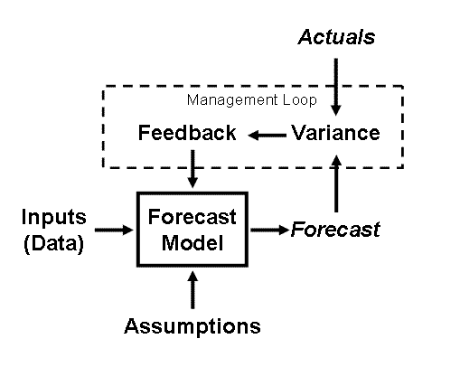
Forecasting process
Notes:
The basic structure of a forecast model is shown above. Certain inputs (data) and assumptions feed the model, and a forecast is created of some variable. With every forecast, though, it is important to manage the process through comparisons of the actuals to the forecast and then working back through the model to understand why. This process is critical to developing a solid forecast methodology.
http://www.practicalforecasting.com/forecast-structure.html

Slide 100
System model
Demand λ
Average number in the system L
Throughput TH
Time in process LT

Slide 101
The deeper we get into a system, the more details we uncover, then the more unique the system looks, the more difficult it seems to generalize the system into a model.

Slide 102
The only valid model of a human system is the system itself.
Murray Gell-Mann, received the 1969 Nobel Prize in Physics
J. G. Boulton, P. M. Allen and C. Bowman, Embracing Complexity, Oxford University Press, 2015
Notes:
Human complex adaptive systems are different because human beings are different – we have intelligence, many identities and intent. Humans are capable of shifting a system from complexity to order and maintain it there in such a way that it becomes predictable¹. As Murray Gell-Mann, an American physicist who received the 1969 Nobel Prize in physics famously said: “The only valid model of a human system is the system itself”. An example of a CAS is a team developing software for a client.

Slide 103
That also results in a belief in most organizations that their problem is somehow uniquely complex.

Slide 104
If we get into too much details then you yourself will never believe them!

Slide 105
It is better to be approximately right than to be precisely wrong. —Warren Buffett

Slide 106
All measurements of any interest to a manager must support at least one specific decision.

Slide 107
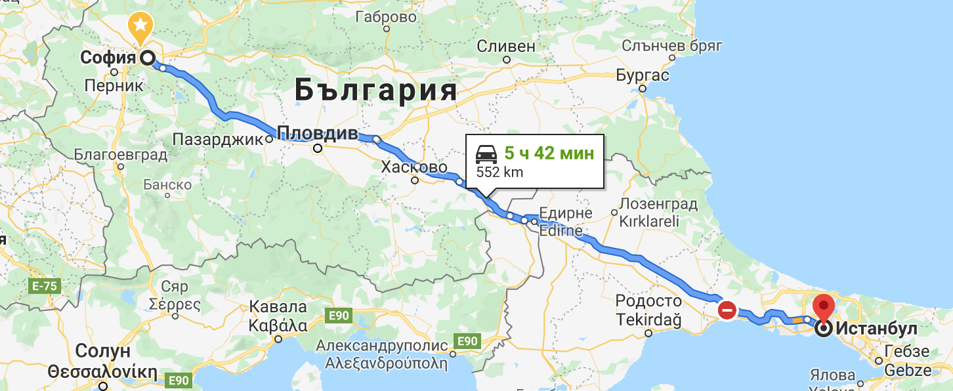
Travel

Slide 108
Risk is simply a state of uncertainty where some possible outcomes involve a loss of some kind.

Slide 109
The reason why a measurement is important to a business is because of the existence of risk.

Slide 110
Project management paradigm believes uncertainty play a role in project management uncertainty could be eliminated by a more detailed planning.
Notes:
It does recognize that uncertainty play a role in project management but believes uncertainty could be eliminated by a more detailed planning. It models projects as a network of activities and calculates the time needed to deliver a project by estimating the effort required to accomplish each activity of work contained in the project’s work breakdown structure.

Slide 111
We challenge the project management paradigm and suggest that for planning purposes it is better to model projects as a flow of work items through a system.

Slide 112
A project is a batch of work items each one representing independent customer value that must be delivered on or before due date.
Notes:
Hence the definition - a project is a batch of work items each one representing independent customer value that must be delivered on or before due date. The batch contains all the work that needs to be accomplished to deliver a new product with specified capabilities. In order to prepare the batch the product scope needs to be broken down into work items each one representing independent customer value. Even for a quality related requirements or such as “the system should scale horizontally” we need to have a work item. It is important that each one of the work items can be delivered in any order like the user stories created following the INVEST mnemonic.

Slide 113
We don’t try to estimate the size of the work items. There are only two "sizes" - “Small Enough" and “Too Big". "Too big" should be split and not allowed to enter the backlog.
Notes:
We don’t try to estimate the size of the work items. There are only two "sizes" - "small enough" and "too big". The two sizes are context specific. They have no correlation to the "effort" needed. "Too big" should be split and not allowed to enter the backlog.

Slide 114

Reference class forecasting (RFC)
Reference class forecasting promises more accuracy in forecasts by taking an "outside view" on the project being forecasted based on knowledge about actual performance in a reference class of comparable projects.
Daniel Kahneman
Notes:
We plan probabilistically by using reference class forecasting which does not try to forecast the specific uncertain events that could affect the new project, but instead places the project in a statistical distribution of outcomes from the class of reference projects.
Reference Class Forecasting is based on the work of the Princeton’s psychologist Daniel Kahneman who won the Nobel Prize in economics in 2002.

Slide 115
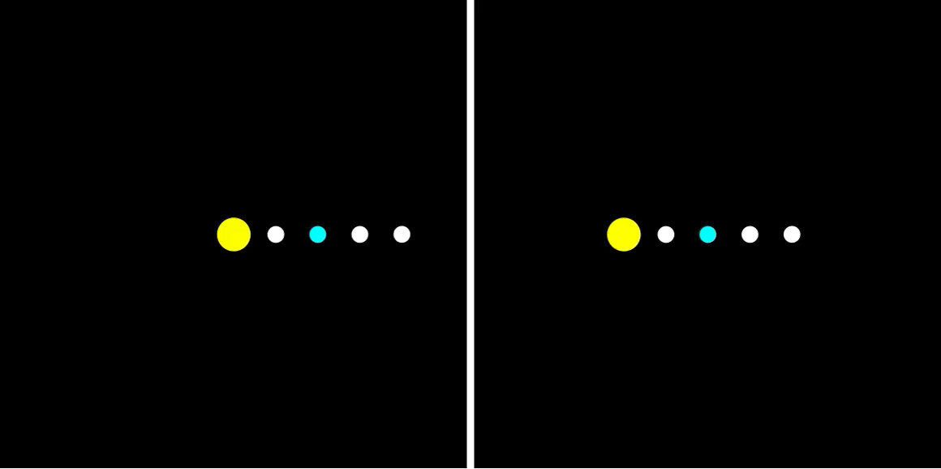

Slide 116
RFC Today
He is Professor of Major Programme Management at Oxford University's Saïd Business School and the first Director of the University's BT Centre for Major Programme Management. His research has shown that competition between megaprojects and their sponsors creates political and organizational pressures that leads to the consistent overestimating of project benefits and the underestimating of project costs.
Bent Flyvbjerg

Slide 117
Reference class forecasting
Identification of a relevant reference class of past, similar projects. The class must be broad enough to be statistically meaningful but narrow enough to be comparable with the specific project.
Establishing a probability distribution for the selected reference class.
Comparing the new project with the reference class distribution, in order to establish the most likely outcome for the new project.
Notes:
Reference class forecasting for a particular project requires the following three steps:
Identification of a relevant reference class of past, similar projects. The class must be broad enough to be statistically meaningful but narrow enough to be comparable with the specific project.
Establishing a probability distribution for the selected reference class. This requires access to credible, empirical data for a sufficient number of projects within the reference class to make statistically meaningful conclusions.
Comparing the new project with the reference class distribution, in order to establish the most likely outcome for the new project.
Let’s apply reference class forecasting method for forecasting the delivery time for a new project.

Slide 118



Identification of a reference class of similar projects
Notes:
Identification of a reference class of similar projects
The projects in the reference class should have comparable:
Team structures
Technologies used
Development processes used and the method of capturing the requirements
Client types
Business domains
Please note that along with the internal characteristics of the projects we also compare the contexts in which projects were executed. The same team may have different performance if the client is a startup or Fortune 500 corporation due to the different way of collaboration with the stakeholders. On the other hand when comparing the projects we should not go into great details. Our goal is to establish a reference class that is broad enough to be statistically meaningful but narrow enough to be comparable with the new projects we will be working on.

Slide 119

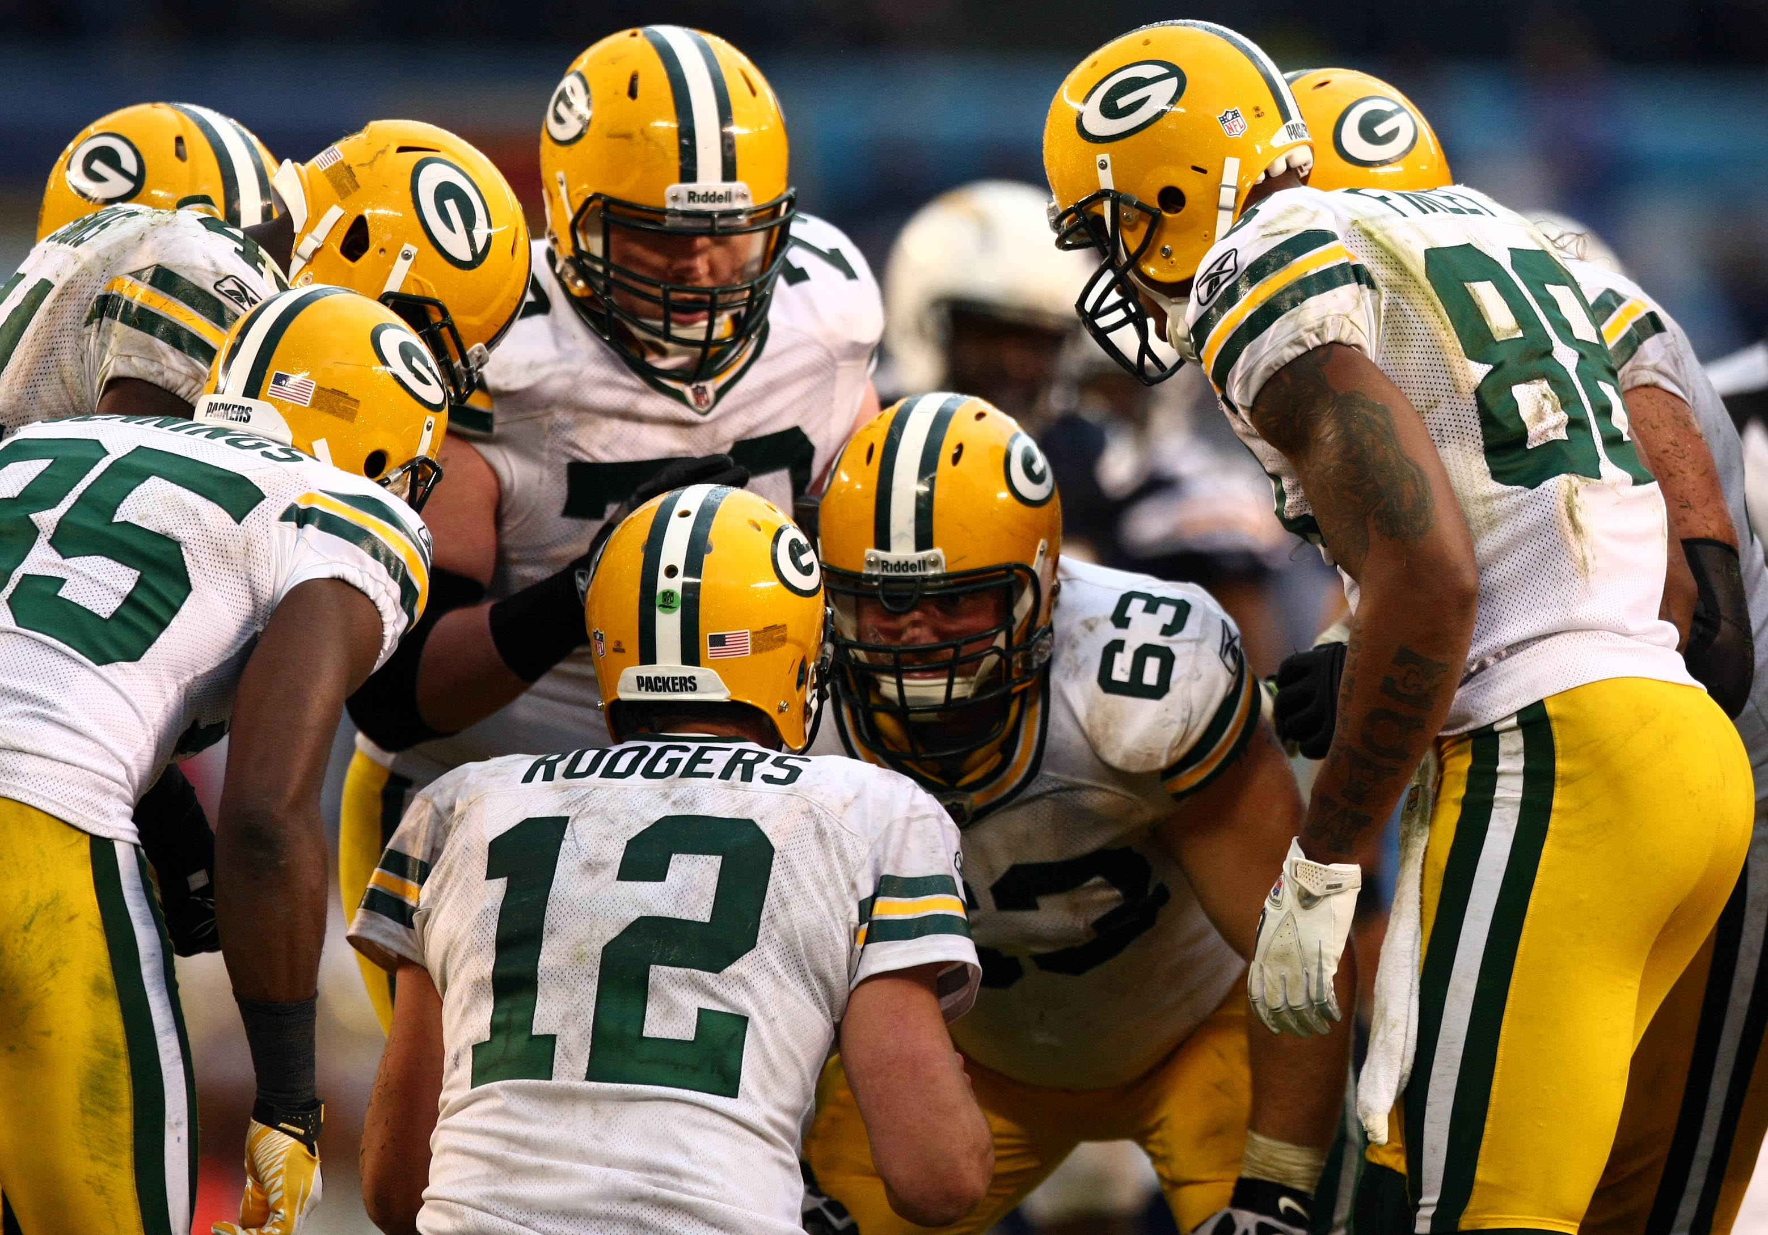
Are the Team structures comparable?
Notes:
Are the Team structures comparable?

Slide 120


Are the Technologies used comparable?
Notes:
Are the Technologies used comparable?

Slide 121


Are the Development processes comparable?
Notes:
Are the Development processes comparable?

Slide 122


Are the Client types comparable?
http://blog.7geese.com/2013/07/04/7-reasons-why-i-decided-to-work-for-a-startup/
Notes:
Are the Client types comparable?

Slide 123


Are the Business domains comparable?
http://www.mindoceantech.com/
Notes:
Are the Business domains comparable?
Please note that along with the internal characteristics of the projects we also compare the contexts in which projects were executed. The same team may have different performance if the client is a startup or Fortune 500 corporation due to the different way of collaboration with the stakeholders. On the other hand when comparing the projects we should not go into great details. Our goal is to establish a reference class that is broad enough to be statistically meaningful but narrow enough to be comparable with the new projects we will be working on.

Slide 124
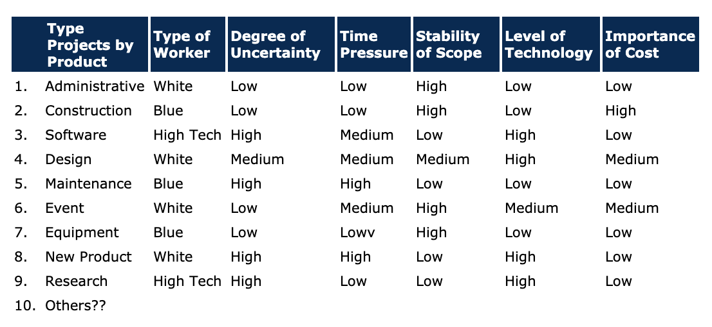

Slide 125

Practice finding reference classes
Experience RCF in action
Excel
20 Minutes
Web
Excel time!

Slide 126
Forecasting project delivery time using Reference Class Forecasting (RCF)
How big?
Notes:
_25 minutes_ (Participants will apply RCF, Monte Carlo and bootstrapping to forecast of project delivery time using MS Excel and actual, but obfuscated, historical data.)
http://www.infoq.com/articles/noestimates-monte-carlo

Slide 127
Establishing a probability distribution for the selected reference class

Slide 128
What metric will be used in the forecast?
The metric should allow us:
to take an “outside view” on the development system that worked on the project
calculating delivery time
make sense from client’s perspective.
Notes:
We need to decide the metric for which we will establish the probability distribution. The metric should allow us to take an “outside view” on the development system that worked on the project, allow for calculating delivery time and should also make sense from client’s perspective. Takt Time is such a metric.

Slide 129
Throughput
Notes:
We need to decide the metric for which we will establish the probability distribution. The metric should allow us to take an “outside view” on the development system that worked on the project, allow for calculating delivery time and should also make sense from client’s perspective. Takt Time is such a metric.

Slide 130
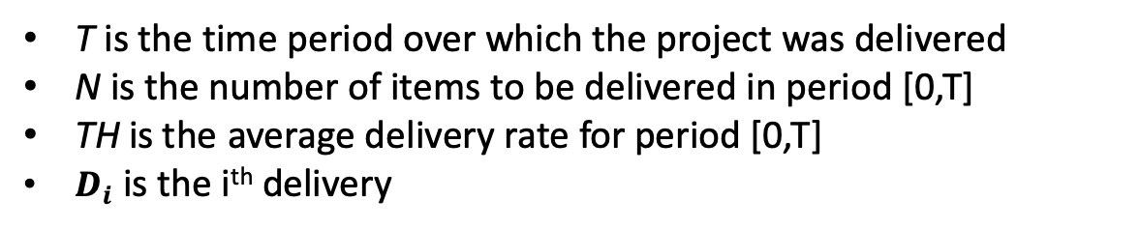
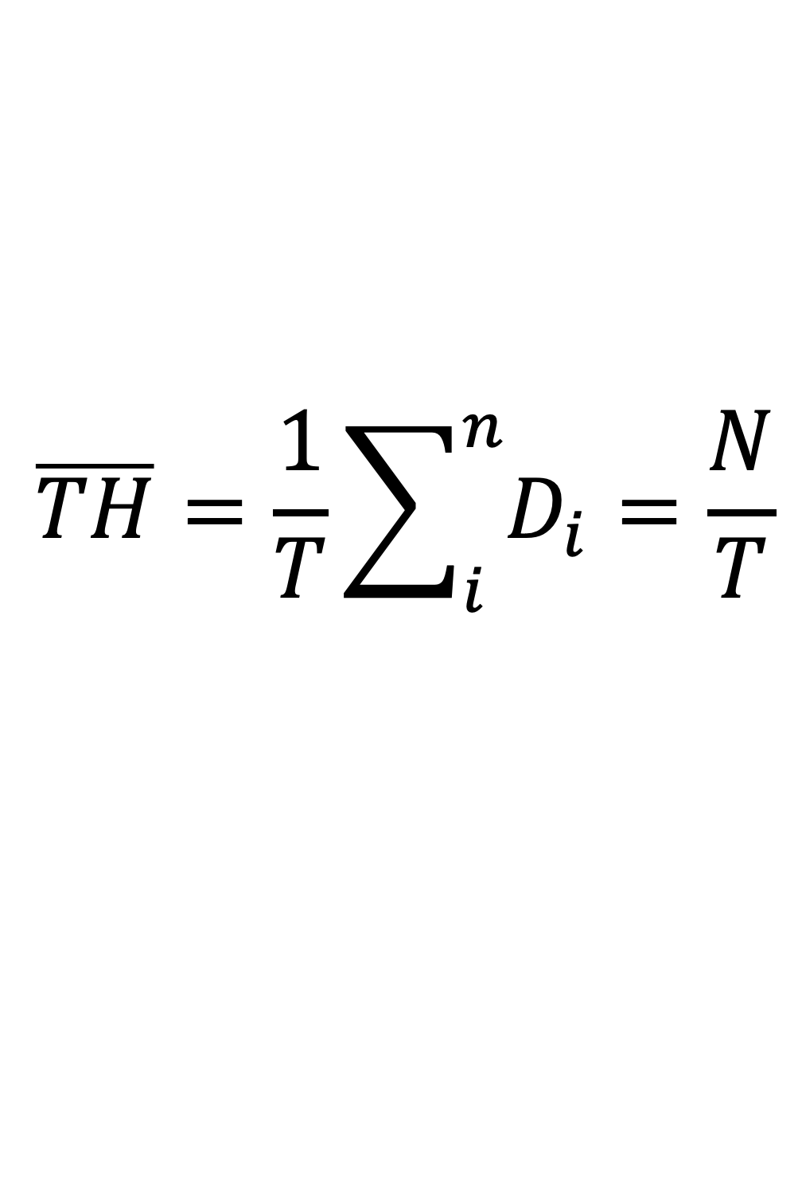
Throughput (TH)
$$\overline{TH}=\frac{1}{T}\sum_{i}^{n}{D_{i}}=\frac{N}{T}$$
T is the time period over which the project was delivered
N is the number of items to be delivered in period [0,T]
TH is the average delivery rate for period [0,T]
$D_{i}$ is the i^{th} delivery
Notes:
Average Takt Time is calculated by dividing over which the project is or will be delivered by the number of work items delivered.
T is the time period over which the project was delivered
N is the number of items to be delivered or the total arrivals in [0,T]
is the Takt Time at the development organization level

Slide 131
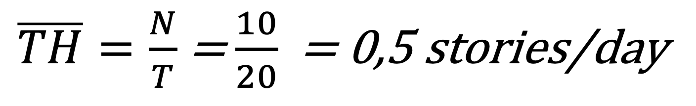
Throughput calculation
$\overline{TH}=\frac{N}{T}$ = $\frac{10}{20}$ = 0,5 stories/day
Note that it is an unqualified average, a single number without variance.
Notes:
In our project we have 22 days delivery time and we have 10 stories delivered hence we have Takt Time of 2.2 days.
That means that on average the time between two successive deliveries is 2.2 days. Note that it is an unqualified average, a single number without variance.

Slide 132
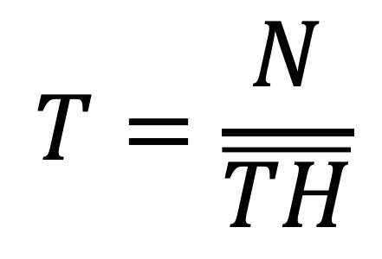
Project Delivery time
$$T=\frac{N}{\overline{TH}}$$
T is the time period over which the project will be delivered
N is the number of items to be delivered in period [0,T]
TH is the Throughput for period [0,T]
Notes:
If we know the Takt Time for the system and we have a number of N work items to be delivered we can calculate how much time will take the system to deliver all N work items. The formula is Takt Time times the number of work items to be delivered.

Slide 133
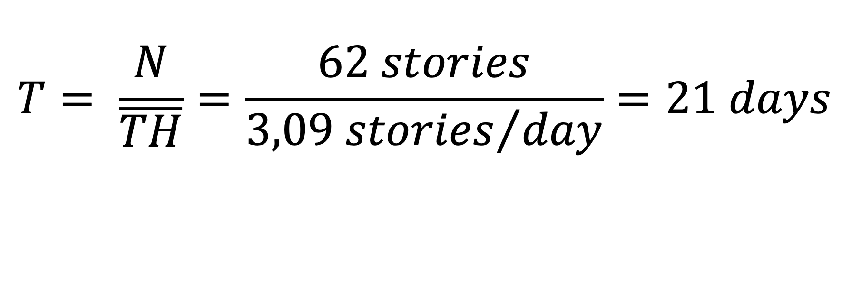
Project Delivery time calculation
$$T= \frac{N}{\overline{TH}}=\frac{62 stories}{{3,09 stories}/{day}}=21 days$$

Slide 134
Practice Calculate Project Delivery Time
Experience RBS in action
Excel
10 Minutes
PDT_empty.xlsx
Excel time!

Slide 135
We should NOT use the Throughput as a single number but a distribution of the Throughput instead!

Slide 136
Probability Management
https://www.probabilitymanagement.org/

Slide 137
Some of the People behind…
Harry Markowitz
Sam Savage
Doug Hubbard

Slide 138
Using parametric distributions for TH

Slide 139
Throughput as Distribution
Experience RBS in action
Excel
10 Minutes
MonteCarlo_DIST_PDT.xlsx
Excel time!

Slide 140
Bootstrapping
Introduced by Bradley Efron in 1979
Based on the assumption that a random sample is a good representation of the unknown population.
Done by repeatedly re-sampling a dataset with replacement, calculating the statistic of interest and recording its distribution.
Does not replace or add to the original data.
Bootstrap distributions usually approximate the shape, spread, and bias of the actual sampling distribution.
Notes:
Using historical samples via bootstrapping we can infer the distribution of TH and its likelihoods.
Bootstrapping is based on the assumption that the sample is a good representation of the unknown population. Bootstrapping is done by repeatedly re-sampling a dataset with replacement, calculating the statistic of interest and recording its distribution. It does not replace or add to the original data.
https://www.youtube.com/watch?v=H2tOhMaXWvI
https://en.wikipedia.org/wiki/Bootstrapping_(statistics)

Slide 141
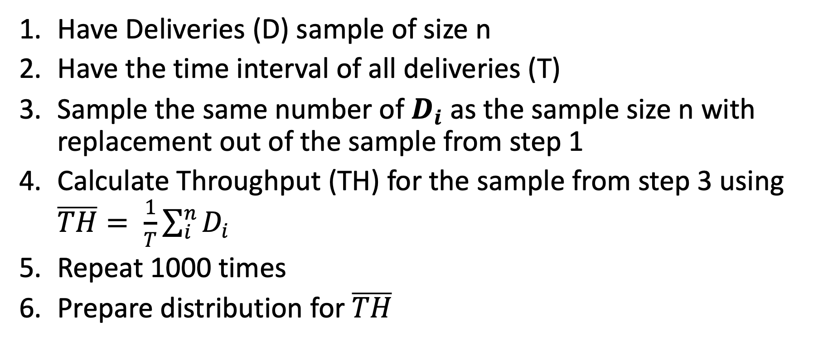
Bootstrapping the distribution of Throughput
Have Deliveries (D) sample of size n
Have the time interval of all deliveries (T)
Sample the same number of $D_{i}$ as the sample size n with replacement out of the sample from step 1
Calculate Throughput (TH) for the sample from step 3 using $\overline{TH}= \frac{1}{T}\sum_{i}^{n}{D_{i}}$
Repeat 1000 times
Prepare distribution for $\overline{TH}$

Slide 142
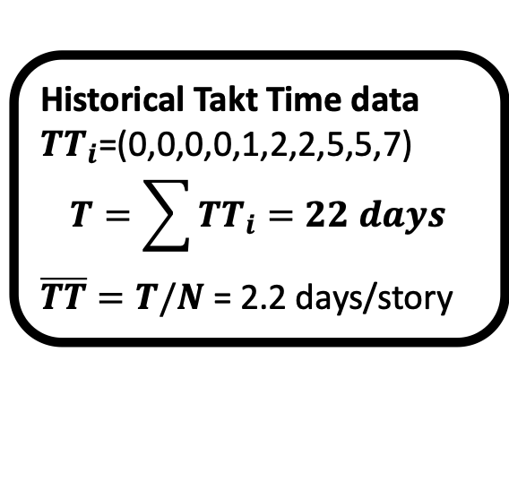
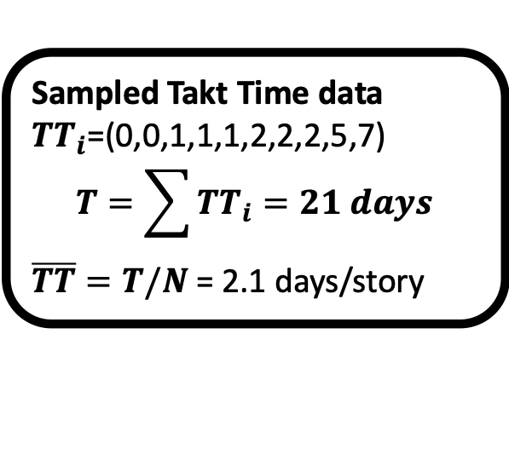
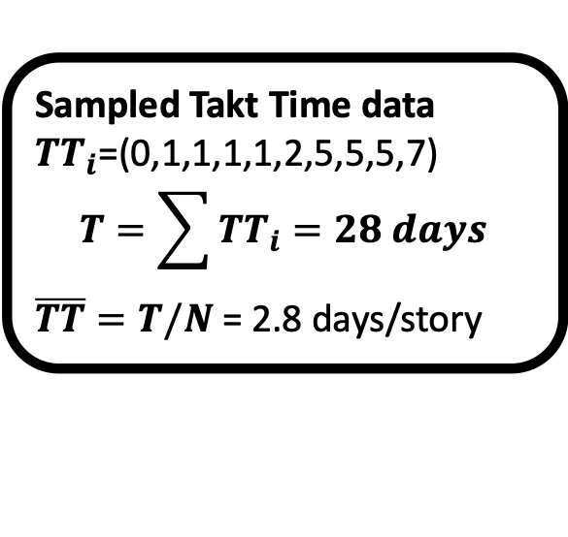
Example: Bootstrapping Throughput (TH)
Sampled Takt Time data
${TT}_{i}$=(0,0,1,1,1,2,2,2,5,7)
$$T=\sum{{TT}_{i}=21 days}$$
$\overline{TT}=T/N$= 2.1 days/story
1st draw with replacement
Historical Takt Time data
${TT}_{i}$=(0,0,0,0,1,2,2,5,5,7)
$$T=\sum{{TT}_{i}=22 days}$$
$\overline{TT}=T/N$= 2.2 days/story
Another 998 draws with replacement
Sampled Takt Time data
${TT}_{i}$=(0,1,1,1,1,2,5,5,5,7)
$$T=\sum{{TT}_{i}=28 days}$$
$\overline{TT}=T/N$= 2.8 days/story
1000th draw with replacement

Slide 143
Result: Throughput(TH) distribution

Slide 144
Practice Bootstrapping
Experience RBS in action
Excel
10 Minutes
MonteCarlo_PDT.xlsx; MonteCarlo_PDT_empty.xlsx
Excel time!

Slide 145
Probabilistic Project Delivery time

Slide 146
Practice Project delivery time forecasting
Experience RBS in action
Excel
20 Minutes
MonteCarlo_PDT.xlsx
Excel time!

Slide 147
Non-linearity

Slide 148
TH assumes linear delivery rate
Notes:
Important thing to note is that assumes linear delivery rate. Do projects have linear delivery rate? Not really.

Slide 149
Most projects have non-linear delivery rate
Notes:
This is a diagram that visualizes the rate at which the work items were delivered. On the X axis we have the project time in days. On the Y axis we have the number of work items delivered each day. It turns out that the delivery rate follows a “Z-curve pattern” (Anderson, 2003) as visualized by the red line.

Slide 150
S-curve
Notes:
The Z-curve can be divided in three parts or we can say it has three legs. There is empirical evidence that 20% of the time the delivery rate will be slow. Then for 60% of the time we’ll go faster or it’s “the hyper productivity” period. And the 20% till the end we’ll go slowly. Of course numbers may vary depending on the context but the basic principle about the three sections is correct.
Only the second Z-curve leg is representative for the Dev System capability. It shows the common cause variation specific to each Dev System process.
First and third Z-curve legs are project specific and are affected by special cause variation.

Slide 151
Each leg of the S-curve is characterized by
Different work type
Different level of variation
Different staffing in terms of headcount and level of expertise
Notes:
Each leg of the Z-curve is characterized by:
Different work type
Different level of variation
Different staffing in terms of headcount and level of expertise

Slide 152
1st leg – Setup time
climbing the learning curve
conducting experiments to cover the riskiest work items
Innovation!
setting up environments
adapting to client’s culture and procedures
understanding new business domain
mastering new technology
Notes:
The first leg of the Z-curve is the time when the developers climb the learning curve and setup their minds for the new project. But this leg of the Z-curve could also be used for:
conducting experiments to cover the riskiest work items
Innovation!
setting up environments
adapting to client’s culture and procedures
understanding new business domain
mastering new technology
All above are examples of special causes of variation specific to a project.

Slide 153

2nd leg – Productivity period
If the project is scheduled properly the system should be like a clockwork – sustainable pace, no stress, no surprises…
Notes:
The second leg of the Z-curve is the productivity period. If the project is scheduled properly the system should be like clockwork – sustainable pace, no stress, no surprises…

Slide 154

3rd leg – Cleaning up
Clean up the battlefield
Fix some outstanding defects
Support the transition of the project deliverable into operation
https://www.ocoos.com/me/professional-dog-training-in-home/
Notes:
The third leg of the Z-curve is when the team will clean up the battlefield, fix some outstanding defects and support the transition of the project deliverable into operation.

Slide 155
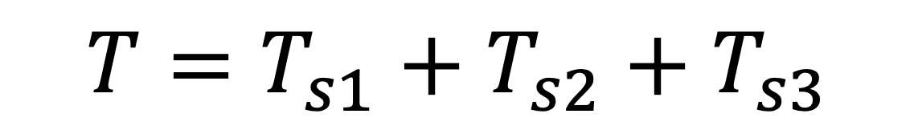
Project delivery time T
$$T=T_{s1}+T_{s2}+T_{s3}$$
Where
Ts1 is the duration of the 1st leg
Ts2 is the duration of the 2nd leg
Ts3 is the duration of the 3rd leg of the S-curve
Notes:
Project delivery time can be represented as a sum of the duration of each one of the three legs of the S-curve. Or in other words it equals the duration of the 1st leg plus the duration of the 2nd leg plus the duration of the 3rd leg of the S-curve.

Slide 156
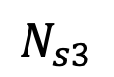
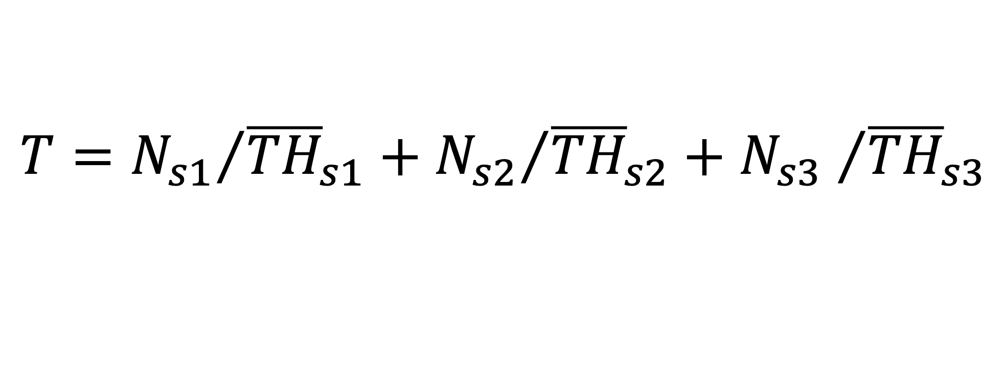
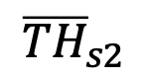
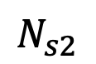
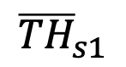
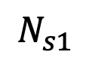
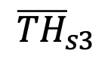
Project delivery time
$$T={N_{s1}}/{{\overline{TH}}_{s1}}+{N_{s2}}/{{\overline{TH}}_{s2}}+{N_{s3} }/{{\overline{TH}}_{s3}}$$
are the work items delivered in the 1st leg
is TH for the 1st leg of the S-curve
are the work items delivered in the 2nd leg
is TH for the 2nd leg of the S-curve
are the work items delivered in the 3rd leg
is TH for the 3rd leg of the S-curve
$$N_{s1}$$
$${\overline{TH}}_{s1}$$
$$N_{s2}$$
$${\overline{TH}}_{s2}$$
$$N_{s3}$$
$${\overline{TH}}_{s3}$$

Slide 157
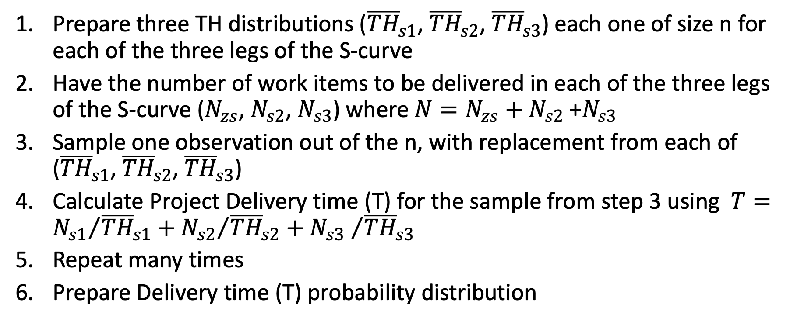
Monte Carlo simulation of Project Delivery Time (T) based on S-curve
Prepare three TH distributions (${\overline{TH}}_{s1}$, ${\overline{TH}}_{s2}$, ${\overline{TH}}_{s3}$) each one of size n for each of the three legs of the S-curve
Have the number of work items to be delivered in each of the three legs of the S-curve ($N_{zs}$, $N_{s2}$, $N_{s3}$) where $N=N_{zs}+N_{s2}$ +$N_{s3}$
Sample one observation out of the n, with replacement from each of (${\overline{TH}}_{s1}$, ${\overline{TH}}_{s2}$, ${\overline{TH}}_{s3}$)
Calculate Project Delivery time (T) for the sample from step 3 using $T={N_{s1}}/{{\overline{TH}}_{s1}}+{N_{s2}}/{{\overline{TH}}_{s2}}+{N_{s3} }/{{\overline{TH}}_{s3}}$
Repeat many times
Prepare Delivery time (T) probability distribution

Slide 158
S-curve Project delivery time forecasting
Experience RBS in action
Excel
20 Minutes
ReferenceProject_SIPMath_S_LT.xlsx
Excel time!

Slide 159
Stochastic Information Packet (SIP)
Comprised of a list of trials of some uncertain parameter or metric generated from historical data using Monte Carlo simulation (resampling)
Represents an uncertainty as an array of possible outcomes (distribution)
It is unique per context (business domain, team, delivery process used etc.)
Notes:
What is this thing called Stochastic Information Packet?
The Stochastic Information Packet or SIP represents an uncertainty as an array of possible outcomes. The concept was formalized in 2006 in an article in OR/MS Today http://probabilitymanagement.org/library/Probability_Management_Part1s.pdf
What is this thing called Stochastic Information Packet?
Every SIP is unique.
We cannot compare one dev system’s historical delivery data with another team. If we do have historical data about average Takt Time it will be invalidated if any of the following happens:
• team structure is changed
• development process is changed
• technology being used is changed
• development process being used is changed - say if introduce pair programming
If anything of the above is changed all historical data will be invalidated including the SIP itself.

Slide 160
A New Project to be delivered
THE SAME Fortune 500 Staffing company
THE SAME development organization
THE SAME technology – Java; Spring; Oracle;
Completely NEW PRODUCT to be delivered
Delivery time TO BE PREDICTED
Notes:
Here we have the new project that we have to plan and provide the customer with delivery date. We have the reference project and when we compare the new project with the reference project we see that the new project is for the same customer, the same team will be working on it, using the same technology. We have to predict the delivery time by simulating is using Monte Carlo.
The New Project to be delivered
THE SAME Fortune 500 Staffing company
THE SAME development organization
THE SAME technology – Java; Spring; Oracle;
Delivery time TO BE PREDICTED

Slide 161
Project scope
After some analysis the team have broken down the requirements into user stories, accounting for Cost of Delay, added work items for Dark matter and Failure load and decided that:
12 stories to be delivered in the 1st leg of S-curve
70 stories to be delivered in the 2nd leg of S-curve
18 stories to be delivered in the 3rd leg of S-curve
Notes:
After some analysis the team has broken down the new project scope into user stories and then has added some more work items to account for Dark Matter and Failure Load. After that the team decided that 12 stories will be delivered in the 1st leg of the Z-curve, 70 stories will be delivered in the 2nd leg of the Z-curve and 18 stories or work items will be delivered by the 3rd leg of the Z-curve.
Dark matter
The number of work items will grow through natural expansion as we investigate them. It is possible some features will be broken into 2 or more once you get started on them. That is why we add work items to compensate for the unknown work or dark matter.
My experience is that I would buffer at least 20% for this and with novice teams on a new product (especially if it was a highly innovative new product where we had no prior knowledge or experience) then I might go as high as 100%.
Failure load
We add work items to compensate for the expected failure load in terms of defects, rework, and technical debt.
Failure load tracks how many work items the Kanban system processes due to poor quality. That includes production defects (bugs) in software and new features requested by the users because of a poor usability or a failure to anticipate properly user needs.
Defects represent opportunity cost and affect the lead time and throughput of the Kanban system. The count of defects is a good indicator if the organization is improving or not.
Add work items to compensate for the unknown work or dark matter. The number of work items will grow through natural expansion as we investigate them. It is possible some features will be broken into 2 or more once you get started on them. My experience is that I would buffer at least 20% for this and with novice teams on a new product (especially if it was a highly innovative new product where we had no prior knowledge or experience) then I might go as high as 100%.
Add work items to compensate for the expected failure load in terms of defects, rework, technical debt.

Slide 162
SIPs of TH distributions for the three legs of S-curve for the reference class
Notes:
We have a reference class of projects and when we compare the new project with the reference class we see that the new project is for the same customer, the same team will be working on it, using the same technology. For the reference class we also have the Takt Time distributions for each of the three legs of the Z-curve.

Slide 163


Monte Carlo simulated summation of…
12 work items
70 work items
18 work items
…will give us the time needed to deliver the project!
Notes:
If we visualize the random variables using their respective PDFs (their “generating functions”) then the Monte Carlo simulated summation of…
…will give us the time needed to deliver the project!
We are simulating this summation say 50,000 times. That will give us the simulated time needed to deliver the new project.

Slide 164
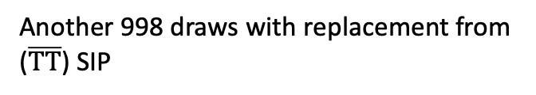
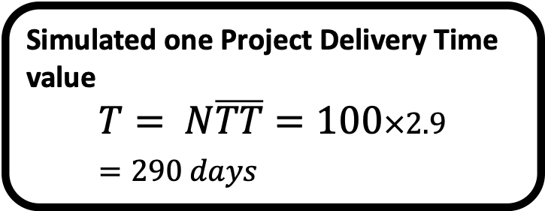
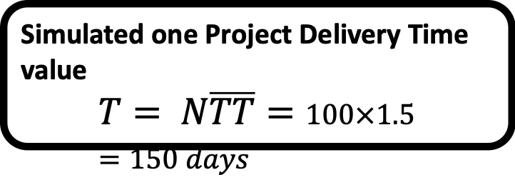
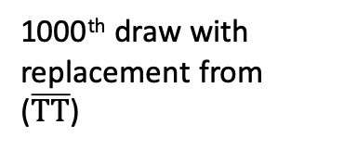
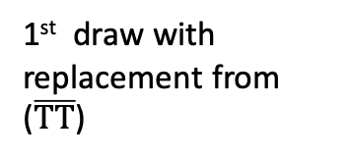
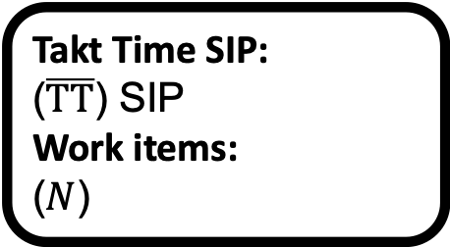
Example: Monte Carlo simulation of Project Delivery Time (T)
Simulated one Project Delivery Time value
$$T= N\overline{TT}=100×1.5=150 days$$
1st draw with replacement from ($\overline{TT}$)
Takt Time SIP:
($\overline{TT}$) SIP
Work items:
($N$)
Another 998 draws with replacement from ($\overline{TT}$) SIP
Simulated one Project Delivery Time value
$$T= N\overline{TT}=100×2.9=290 days$$
1000th draw with replacement from ($\overline{TT}$)

Slide 165
Mode = 183 days; Median = 199 days; Mean = 199 days; 85th perc = 223 days

Slide 166
60:00 minutes
Lunch Break
Come Back in 60 Minutes

Slide 167
Forecasting how big a project is
Forecasting
Notes:
_25 minutes_ (Participants will apply RBS to size a project using MS Excel and actual, but obfuscated, historical data.)
http://www.infoq.com/articles/probabilistic-project-sizing

Slide 168

How big is our project?

Slide 169

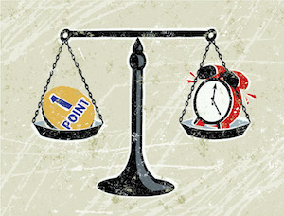
Agile sizing techniques
measure User Stories
T-Shirt sizes (Small, Medium, Large and so on)
http://www.mountaingoatsoftware.com/blog/estimating-with-tee-shirt-sizes
Story points (Fibonacci numbers or Exponential scale)
http://www.mountaingoatsoftware.com/blog/dont-equate-story-points-to-hours

Slide 170


Kanban project sizing? Count!
Number of user stories, features, use cases
Number of tasks
Project size is the total of "work items suitable for the development organization."

Slide 171
Example sizing in tasks
We have identified 16 epics in our project
We have identified that those 16 epics contain 102 user stories in total
We have analyzed and sized every single one of those 102 user stories and arrived at a total number of 396 tasks for our project
This practice is time consuming and probably great part of this effort will be a pure waste!
Notes:
It means that to plan initiatives, features or epics you have to break them down to user stories. It requires quite significant analysis process and it can easily happen that great part of this effort will be a pure waste. Priorities of initiatives and features can change and feature will not be started at all. This practice is hard to follow.

Slide 172
How can we estimate the total number of stories, story points or tasks for a project without prior identification, analysis and sizing of every single user story?

Slide 173
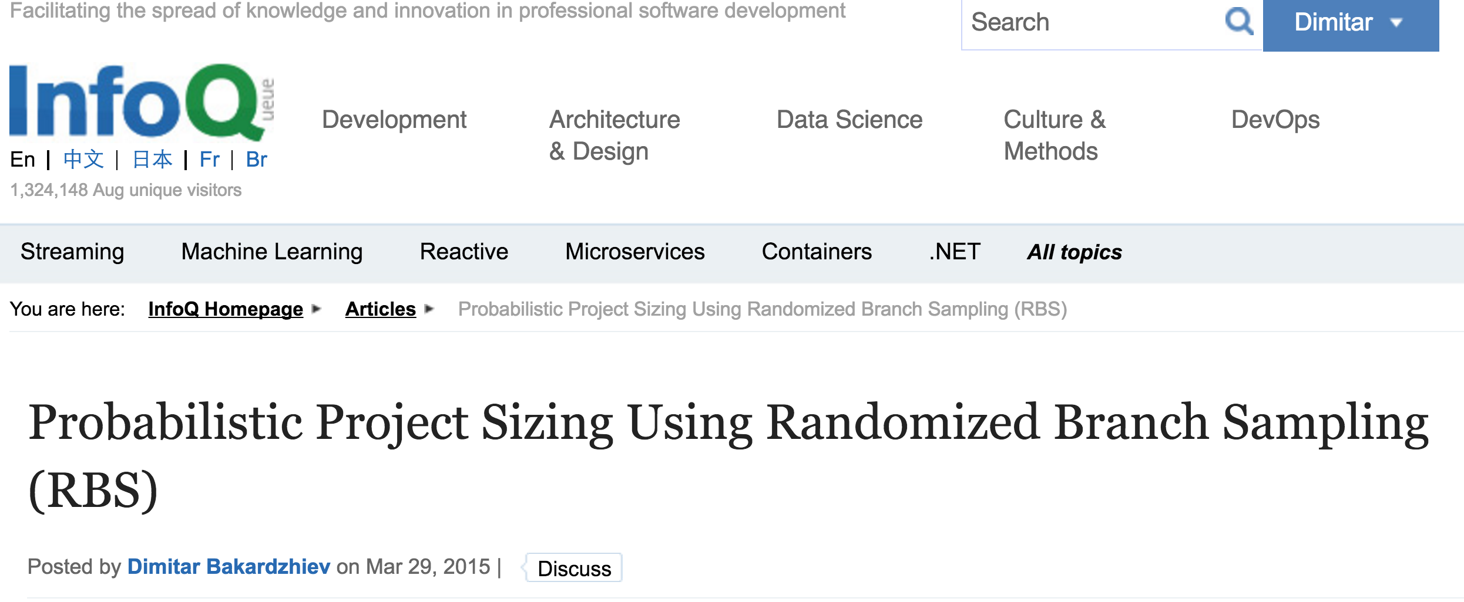

Slide 174
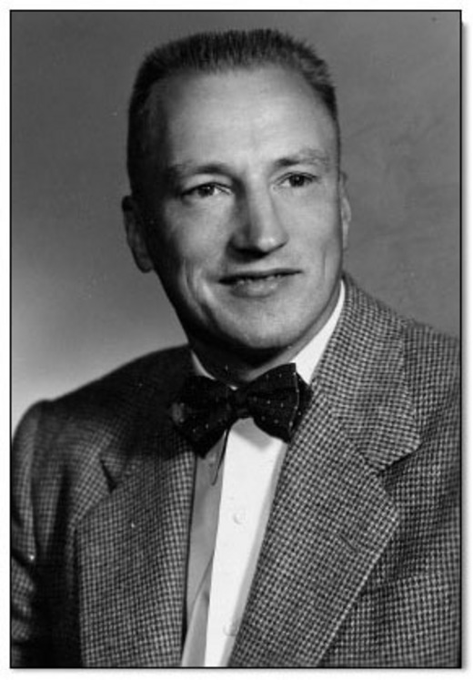
Randomized Branch Sampling
The technique was designed to efficiently estimate the total number of fruit found in the canopy of a tree while only having to count the fruit on select branches. RBS is a method for sampling tree branches which does not require prior identification of all branches, and provides the sampler with unbiased tree level estimates.
Raymond J. Jessen 1910–2003
Notes:
http://senate.universityofcalifornia.edu/inmemoriam/RaymondJessen.htm
Randomized branch sampling (RBS) was first proposed by Jessen (Jessen, 1955). It is a multi-stage unequal probability sampling method. The technique was designed to efficiently estimate the total number of fruit (oranges) found in the canopy of a tree while only having to count the fruit on select branches. RBS is a method for sampling tree branches which does not require prior identification of all branches, and provides the sampler with unbiased tree level estimates.
As an example, we suppose that it is of interest to estimate the total number of fruit on a apple tree. The number of fruit on the tree is the population and it is desired to select a sample from which an estimate of the population's number can be obtained. In the case of the apple tree, the samples to be selected are the terminal branches upon which the fruit is typically borne.

Slide 175
Randomized branch sampling (RBS)
A multi-stage unequal probability sampling method which doesn’t require prior identification of all branches in the crown, and provides the sampler with unbiased tree level estimates
Designed to efficiently estimate the total number of fruit found in the canopy of a tree while only having to count the fruit on select branches
A tree level estimate is derived by combining the number of fruit from the terminal branch and the associated probability with which that particular branch was selected
Notes:
RBS is a method for sampling tree branches which does not require prior identification of all branches, and provides the sampler with unbiased tree level estimates. With RBS, branches are selected from the tree by creating a pathway which starts at the base of the bole and travels upwards. Every time the path encounters a fork (branching), selection probabilities are calculated proportional to the size of each limb emanating from the fork. A random number is then generated to determine the limb through which the path continues to travel along. This procedure is repeated up the tree until the path selects a terminal branch which is small enough that it becomes easy to measure the number of fruit. A tree level estimate is derived by combining the number of fruit from the terminal branch and the associated probability with which that particular branch was selected. RBS is an advantageous sampling scheme in the field because it does not require the user to take measurements on, or to have prior knowledge of all branches in the crown.

Slide 176
Product backlog as a branching system
Product Backlog
Epic A
Epic B
Epic C
User Story 1
User Story 2
User Story 5
User Story 6
User Story 7
User Story 3
User Story 4
Notes:
Epics are the highest-level requirements artifact. Epics are not implemented directly but are broken into user stories, which are the primitives used by the teams for actual coding and testing.  Epics are not directly testable. Instead, they are tested by the acceptance tests associated with the user stories that implement them.
When breaking an epic down do not consider how many steps the workflow will consist of. Consider the user story the only work item type at the lowest level of granularity.

Slide 177
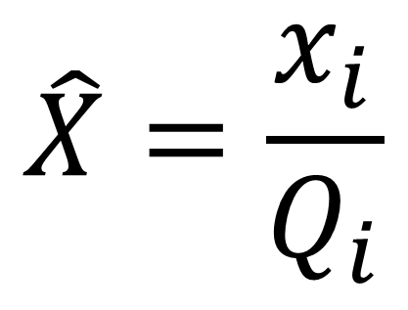

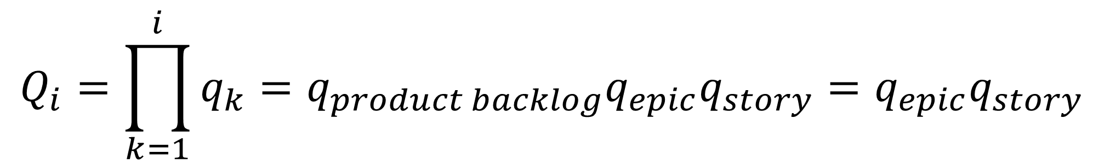
Horvitz-Thompson estimator
Unconditional selection probability ( )
Notes:
In RBS a Horvitz-Thompson estimator is used to derive an unbiased estimate of the total size of the product backlog by dividing the size (x) of a selected user story i by its associated unconditional probability () with which that particular user story was selected. Unbiasedness generally means that the average of the estimates over all possible samples will be identical to the actual project size.
An unconditional selection probability () is obtained from the conditional selection probability of the user story when the conditional probabilities of the product backlog and the epic the story belongs to are accounted for. Since there is only one product backlog its conditional selection probability is 1.

Slide 178
Applications of RBS to project sizing
User Story
The user story rectangle represents the estimated size of a randomly sampled user story. The size of that user story is expanded to an estimated total project size by dividing that size by its selection probabilities which is indicated here by the arrows. The selection probabilities assigned to epics and user stories are arbitrary. Unless the probabilities do not sum to one they will not affect the unbiasedness of the resultant estimate, but they will affect its precision. When applying RBS for sizing a project today we will use the method “probabilities proportional to number” where the total number of epics in the product backlog and the total number of user stories per epic are used to calculate conditional selection probabilities.
Epic
Product
Total size per section level

Slide 179
Is RBS applicable to software development?

Slide 180
The method of analysis used to break down requirements and itemize them for development has its own degree of variability. ~David J. Anderson, Kanban, p.221

Slide 181
Why RBS works?
The assumption behind using RBS for software development is that project size depends on the context – the customer, the people developing the product and the methodology they use for managing the requirements.
RBS estimates the original scope. Then there is a relationship between the original and eventual (emergent, expanded) scope which we only identify when the results of the execution of our plans meet the customer. The scope expansion is referred to as “dark matter”.
Notes:
The assumption behind using RBS for software development is that project size depends on the context – the customer, the people developing the product and the methodology they use for managing the requirements, breaking down the product into stories and sizing a story. It doesn’t matter what the methodology is – Planning Poker (Cohn, 2005), Product Sashimi (Rainsberger, 2012), Behavior Driven Development (North, 2006), Feature Driven Development (Coad, 1999) etc. What is important is the methodology to be cohesive, explicit and to be consistently applied during project execution when we slice the requirements into user stories.
RBS estimates the original scope. Then there is a relationship between the original and eventual (emergent, expanded) scope which we only identify when the results of the execution of our plans meet the customer). The scope expansion occurs when the requirement change risk materializes.

Slide 182
RBS compared to the actual results of 13 real ScrumDo.com projects
Epic-Story-Task breakdowns
Successful release history
Stable teams (systems)
Have an active ScrumDo coach or scrum master
Commercial projects
Have a minimum size of 12 epics/features.
Notes:
https://docs.google.com/spreadsheets/d/1aEG6-pEZKYV0gyBq-nI4I5AqD7h-z-IGIY4f-Wi907I/edit#gid=835013943
I teamed up with Ajay Reddy and the CodeGenesys/ScrumDo.com team to test the correlation between project sizes estimated using RBS and the actual story points estimated in thirteen randomly selected projects from the pool of real Scrumdo projects that met the following criteria:
Epic-Story-Task breakdowns
Successful release history
Stable teams (systems)
Have an active ScrumDo coach or scrum master
Commercial projects
Have a minimum size of 12 epics/features.
As seen on the scatterplot below we found a very strong correlation between project sizes estimated using RBS and the actual number of stories estimated for some real Scrumdo projects.

Slide 183
RBS estimated number of stories

Slide 184
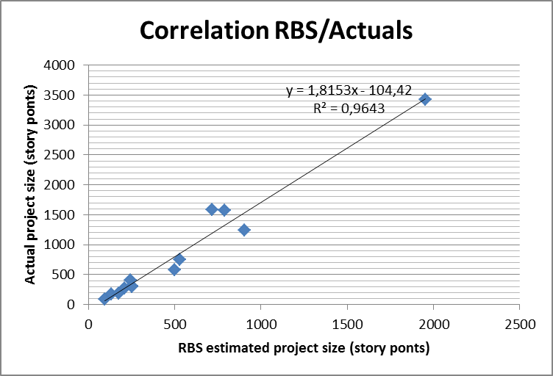
RBS estimated total story points

Slide 185
RBS estimated number of tasks per story

Slide 186
Conclusions from Scrumdo.com data
During project execution all project teams consistently applied a methodology for slicing the requirements into user stories and sizing them using story points
During project execution all project teams maturely managed the emergent and high-change-risk requirements
Execution is more important than planning!!!

Slide 187
Execution is more important than planning!!!

Slide 188
Applications of RBS
Applying RBS for estimating total number of tasks in a project
Applying RBS for estimating total number of user stories in a project
Applying RBS for estimating total Story points in a project

Slide 189
Applying RBS for estimating total number of tasks in a project
Forecasting how big a project is

Slide 190
When we size each user story in the number of tasks then the project size is the total of all tasks.

Slide 191
Tasks based sizing model
Product
…
Epic 1
Epic 2
…
User Story 1
User Story N
…
Task 1
Task N
Notes:
The delivery time per scenario will come from the historical delivery rate of the system.

Slide 192

…
Task 1
Task N
…
User Story 1
User Story N
…
Epic 1
Epic N
Product

Slide 193
Mapping
Product | Trunk
Epic | Branch
User Story | Terminal Shoot
Number of tasks per User story | Number of Fruit on the Shoot
Notes:
Mapping
Product = Trunk
Epic = Branch
User Story = Terminal Shoot
Number of tasks per User story = Number of Fruit on the Shoot

Slide 194
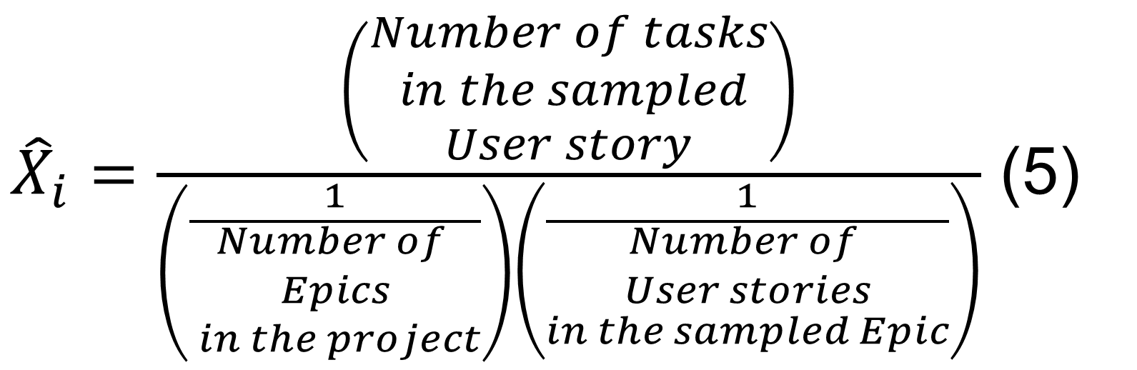
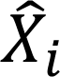
Estimate of the of total number of tasks for a project
Where:
is an unbiased estimator of the population total of the of story points for the project.

Slide 195

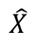
Total number of tasks for the project
Where:
is an unbiased estimator of the total number of tasks for the project.
m is the number of estimates done

Slide 196
Algorithm
Divide the project scope into epics.
Randomly sample one of the epics
Analyze how many stories are in the sampled epic. Write down the number of stories.
Randomly sample one of the stories of the epic from p.2
Establish the tasks for the story from p.4
Using formula (5) calculate one estimate of the total number of tasks for the project
Repeat points 2-6 between 7 and 11 times
Using formula (6) calculate the total number of tasks for the project

Slide 197
Project
20 Epics
183 Stories
480 Tasks
Step 4: Randomly sample one story from each epic.
Step 5: Estimate the size of each of the sampled stories in tasks
Step 1: Break your project down into epics and number them sequentially, starting from 1
Step 2: Randomly sample 7 epics. Duplicates are allowed!
Step 3: Break each of the sampled epics into stories. Number the stories of each epic sequentially, starting from 1.
1
1
1
1
1
1
2
1
1
1
1
1
1
1
1
1
1
1
1
1
1
1
8
1
1
1
1
1
1
1
1
1
1
1
1
1
1
1
5
1
1
1
1
1
1
1
1
Notes:
Step 1: Break your project down into epics and number them sequentially, starting from 1
Step 2: Randomly sample 7 epics. Duplicates are allowed!
Step 3: Break each of the sampled epics into stories. Number the stories of each epic sequentially, starting from 1.
INTERM RESULT: Estimate the total number of stories in the project
Step 4: Randomly sample one story from each epic
Step 5: Estimate the size of each of the sampled stories in Story Points
FINAL RESULT: Estimated total number of Story Points in the project

Slide 198
Applying RBS for estimating total number of user stories in a project
Forecasting how big a project is

Slide 199
Stories based sizing model
Product
…
Epic 1
Epic N
…
User Story 1
User Story N

Slide 200
…
User Story 1
User Story N
…
Epic 1
Epic N
Product

Slide 201
Mapping
Product | Trunk
Epic | Branch
User Story | Terminal Shoot
Notes:
Mapping
Product = Trunk
Epic = Branch
User Story = Terminal Shoot

Slide 202
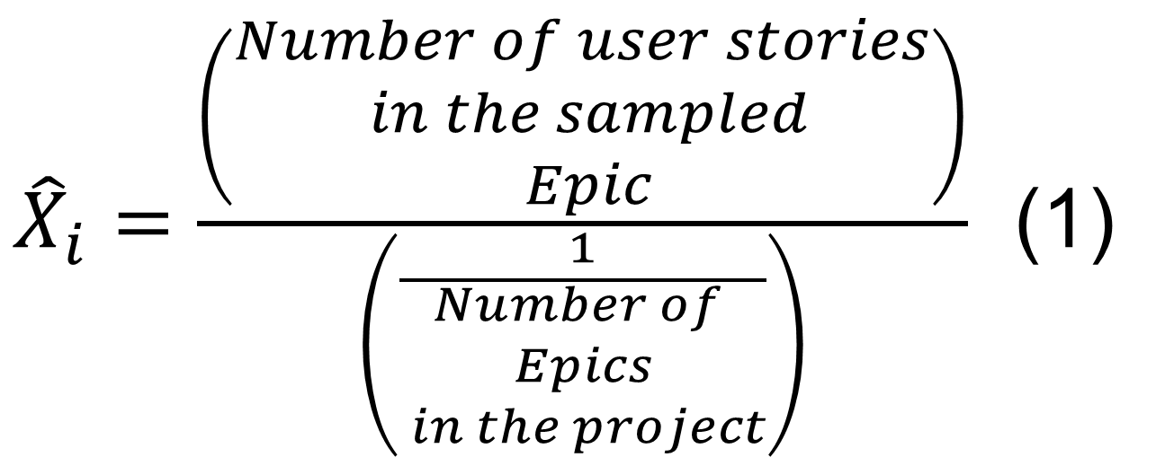
RBS estimate of the of total number of user stories for a project
Where:
is an estimate of the total number of user stories for the project.

Slide 203
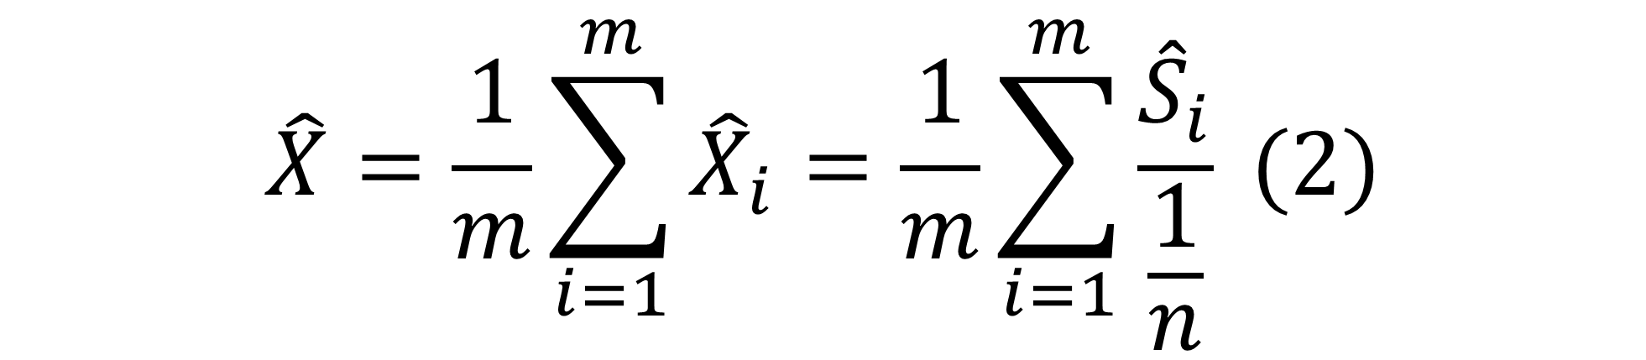
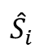
Total number of user stories for the project
is an unbiased estimator of the number of user stories
is the number of user stories in the m-th epic
m is the number of estimates done
n is the number of epics in the project

Slide 204
Algorithm
Divide the project scope into epics.
Randomly sample one of the epics
Analyze how many stories are in the sampled epic. Write down the number of stories.
Using formula (1) calculate one estimate of the total number of stories for the project.
Repeat steps 2 - 4 between 7 and 11 times.
Using formula (2) calculate the total number of stories for the project.

Slide 205
Applying RBS for estimating total Story points in a project
Forecasting how big a project is

Slide 206
Story points based sizing model
Project
…
Epic
Epic
…
User Story
User Story
Story points
Story points
Notes:
Epics are the highest-level requirements artifact. Epics are not implemented directly but are broken into user stories, which are the primitives used by the teams for actual coding and testing.  Epics are not directly testable. Instead, they are tested by the acceptance tests associated with the user stories that implement them.
When breaking an epic down do not consider how many steps the workflow will consist of. Consider the user story the only work item type at the lowest level of granularity.

Slide 207
X Story points
Y Story points
…
User Story 1
User Story N
…
Epic 1
Epic N
Product

Slide 208
Mapping
Product | Trunk
Epic | Branch
User Story | Terminal Shoot
Story points per story | Number of Fruit on the Shoot
Notes:
Product = Trunk
Epic = Branch
User Story = Terminal Shoot
Story points = Number of Fruit on the shoot

Slide 209
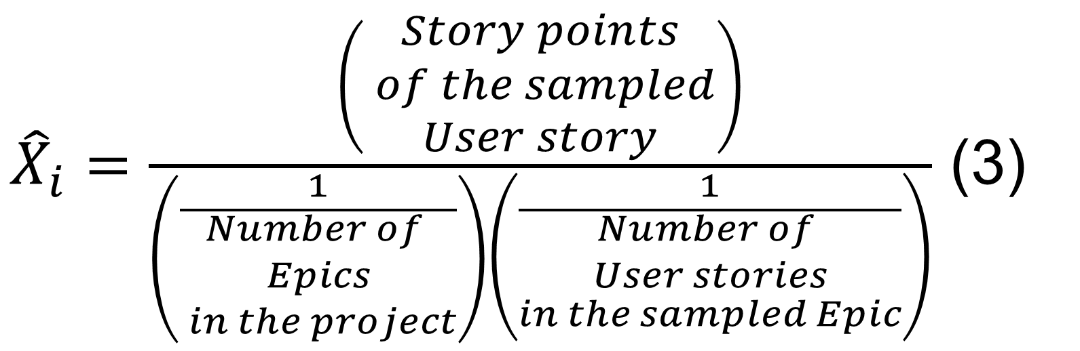
Estimate of the of total story points for a project
Where:
is an unbiased estimator of the population total of the of story points for the project.

Slide 210

Total story points for the project
Where:
is an unbiased estimator of the total story points for the project.
m is the number of estimates done

Slide 211
Algorithm
Divide the project scope into epics.
Randomly sample one of the epics
Analyze how many stories are in the epic. Write down the number of stories.
Randomly sample one of the stories of the epic from p.2
Estimate the story points for the story from p.4
Using formula (3) calculate one estimate of the total story points for the project
Repeat points 2-6 between 7 and 11 times
Using formula (4) calculate the total story points for the project

Slide 212
Following is a calculation with data from a real ScrumDo.com project. When the project finished there were delivered 20 epics, 176 user stories and a total of 573,5 story points.

Slide 213
Project
20 Epics
197 Stories
500 Story Points
Step 4: Randomly sample one story from each epic.
Step 5: Estimate the size of each of the sampled stories in Story Points
Step 1: Break your project down into epics and number them sequentially, starting from 1
Step 2: Randomly sample 7 epics. Duplicates are allowed!
Step 3: Break each of the sampled epics into stories. Number the stories of each epic sequentially, starting from 1.
1
1
1
1
1
1
2
1
1
1
1
1
1
1
1
1
1
1
1
1
1
1
8
1
1
1
1
1
1
1
1
1
1
1
1
1
1
1
5
1
1
1
1
1
1
1
1
Notes:
Step 1: Break your project down into epics and number them sequentially, starting from 1
Step 2: Randomly sample 7 epics. Duplicates are allowed!
Step 3: Break each of the sampled epics into stories. Number the stories of each epic sequentially, starting from 1.
INTERM RESULT: Estimate the total number of stories in the project
Step 4: Randomly sample one story from each epic
Step 5: Estimate the size of each of the sampled stories in Story Points
FINAL RESULT: Estimated total number of Story Points in the project

Slide 214
Practice RBS
Experience RBS in action
Excel
20 Minutes
Web
Excel time!
Calculate with 1 epic!

Slide 215
http://modernmanagement.bg/rbs/

Slide 216
10:00 minutes
Coffee Break
Come Back in 10 Minutes

Slide 217
Forecasting staffing
Notes:
Participants will apply Little's Law to forecast the number of developers needed to deliver a project. (10 minutes)
http://www.infoq.com/articles/probabilistic-project-planning

Slide 218
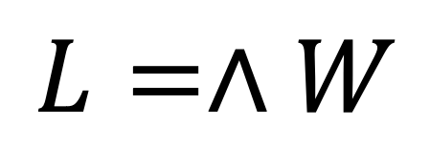
Little’s Law
$$L=∧W$$
Notes:
What kind of averages? Each of the quantities in the
formula is a different average with different dimensions. L
is a time average of the number of items in the system,
and so is dimensionless. W is the sample average of the
waiting times of individual items, and so is measured in
time units. ã is an average rate calculated by counting the
points of arrival in 601T 7 and dividing by T , and so has the
dimensions of items per unit time. All of them are common
forms of averages that seem natural.

Slide 219
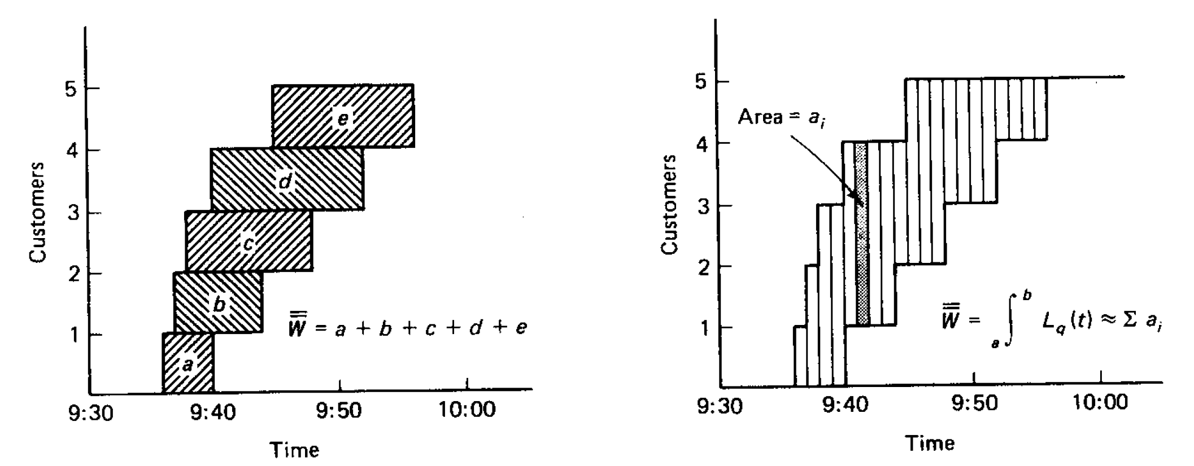
Total waiting time for all customers

Slide 220
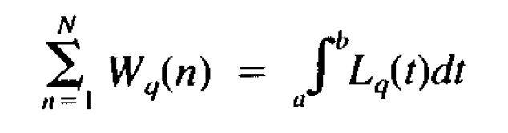
Total waiting time for all customers

Slide 221


Little’s Law for production systems
$$\overline{TH}=\frac{\overline{WIP}}{\overline{LT}}$$
Notes:
Let’s recall what the Little’s Law for production systems is…
Where throughput (TH) is the average output of the production process per unit time, work in process (WIP) is the average inventory between the start and end points of the production process per the same unit of time, and lead time (LT) is the average time from starting a job at the beginning of the production process until it reaches the end of the production process (that is, the time the job spends as WIP) in the same unit of time.
Note that lead time is also referred to as flow time, throughput time, and sojourn time, depending on the context.

Slide 222
Little’s Law holds in case of a project
We must have conservation of Flow
The average output or departure rate (TH) equals the average input or arrival rate (λ)
There are no work items that get lost or never depart from the system
The system must occasionally empty, i.e., WIP = 0
Notes:
The conditions necessary for Little’s Law to hold are:
At a minimum, we must have conservation of flow. Thus, the average throughput or departure rate equals the average input or arrival rate. Furthermore, we need to assume that all work items that enter the system will eventually be completed and will exit the system; there are no work items that get lost or never depart from the system.
Little's Law holds exactly between any two times at which the system is empty. For a project, it means that we start with a batch of work items and when we deliver, there are no items left in the development system.
For a project, both conditions are true, so Little’s Law holds.

Slide 223
Little’s Law can help us calculate the average Lead Time for a work item.
But we need a relationship between the average Lead Time for a work item and the finite time period over which the project will be delivered!
Notes:
Little's Law deals with averages. It can help us calculate the average waiting time of an item in the system. In project development we break the project delivery into work items. We are interested in how much time it will take for all the items to be processed by the system.
We need a relationship between the average lead time for a work item and the finite time period over which the project will be delivered.

Slide 224
Little’s Law applies to any system, and particularly, it applies to systems within systems
Notes:
Little’s Law applies to any system and, most importantly, it applies to systems within systems. So, in a bank, the queue in front of the tellers might be one subsystem and each of the tellers is another subsystem, and Little’s Law could be applied to each as well as to the whole thing.

Slide 225


Project delivery system
Project system
Dev system
New Work
Delivered Work
Project backlog N
S1
Dev ${\overline{WIP}}_{t}$
S2
$${\overline{LT}}_{t}$$
T
Notes:
Where:
T is the time period over which the project will be delivered (lead time)
N is the number of items to be delivered or the total arrivals in [0,T]
${\overline{WIP}}_{t}$ is the average work in process at the development organization level
${\overline{LT}}_{t}$ is the average lead time (cycle time) at the development organization level

Slide 226
Visual kanban system
Notes:
Let’s see how a project is handled in a kanban system.
We have a batch of 10 work items and they move through the knowledge discovery process of the delivering organization.
At the end all 10 work items are deployed!
The ${\overline{TH}}_{p}$ of the Project System comes from the Dev System hence ${\overline{TH}}_{p}$ cannot be bigger than ${\overline{TH}}_{t}$ and at the same time cannot be smaller!!!!!
${\overline{TH}}_{p}$ and ${\overline{TH}}_{t}$ are equal!

Slide 227
Average throughput of the project system equals the average throughput of the development system!
Notes:
Little’s Law holds only for Dev system. That is what we measure and have historical data about. Hence it is safe to discard a work item from the Project system and break conservation of flow requirement on the project system level.

Slide 228

Proof using mathematical notation
$${\overline{TH}}_{p}={\overline{TH}}_{t}$$
$${\overline{TH}}_{p}=\frac{N}{T}$$
$$T=\frac{N}{{\overline{TH}}_{p}}=\frac{N}{{\overline{TH}}_{t}}=\frac{N}{\frac{{\overline{WIP}}_{t}}{{\overline{LT}}_{t}}}=N\frac{{\overline{LT}}_{t}}{{\overline{WIP}}_{t}}$$
Notes:
The "target throughput" comes from the Z simulation of the anticipated s-curve in work item completion of the Dev system. The WIP limit applies to the columns through which the observed lead time was measured previously. These must be consistent.
T is the time period over which the project will be delivered (lead time)
N is the number of items to be delivered or the total arrivals in [0,T]
${\overline{LT}}_{p}$ is the average lead time at the project level or what the client can see
${\overline{WIP}}_{p}$ is the average work in process at the project level
${\overline{WIP}}_{t}$ is the average work in process at the development organization level
${\overline{LT}}_{t}$ is the average lead time (cycle time) at the development organization level
${\overline{TH}}_{p}$ is the average throughput at the project level
${\overline{TH}}_{t}$ is the average throughput at the development organization level
${\overline{TT}}_{t}$ is the average Takt Time at the development organization level
${\overline{TT}}_{p}$ is the average Takt Time at the project level
Consider the figure where the project is presented as a queuing system consisting of two queuing systems in tandem. Client and development systems are connected in a way that they share the same output. Output from the development system is flowing into the output of the client system. Hence average throughput of the client system is equal to the average throughput of the development system or ${\overline{TH}}_{p}={\overline{TH}}_{t}$. For both systems we have to work with the same time interval for the throughput time and throughput rate i.e. minutes, hours, days, weeks, etc. Also we have to have the same work item type – it is not possible average throughput at the project level to be measured in sites, and average throughput at the development organization level to be measured in web pages.
By noting that ${\overline{TH}}_{p}={\overline{TH}}_{t}$ we have the proof.
$\frac{1}{{\overline{TH}}_{p}}$ is the takt time that we need to achieve in order to deliver in T weeks. Takt time is the waiting time between two deliveries (two occurrences of an event).
$\frac{N}{{\overline{TH}}_{p}}$ equals the mean of an Erlang (Gamma with k as integer) distribution. What does that tell us?
So it can be said that the average time T needed to deliver N work items with average Takt Time=$\frac{1}{{\overline{TH}}_{p}}$ equals $\frac{N}{{\overline{TH}}_{p}}$ or N times Takt Time.

Slide 229

Anderson’s Formula
$$T= N\frac{{\overline{LT}}_{t}}{{\overline{WIP}}_{t}}$$
Notes:
Little's Law deals with averages. It can help us calculate the average waiting time of an item in the system or the average lead time for a work item. In product development, we break the project delivery into a batch (or batches) of work items. Using Anderson’s formula, we can forecast how much time it will take for the batch to be processed by the development system.

Slide 230
Budgeting a project
Major project with 2200 user stories to be delivered
Business needs the project delivered in 10 months
Average lead time for the development organization is 0.4 weeks
Notes:
David Anderson’s original example
We have a major project with 2200 user stories to be delivered. The business needs the project delivered in 10 months. The questions to answer are: How much money do we need? How many people do we need?
So we have N = 2200 user stories, T=10 months = 40 weeks. We also have historical data that average lead time for the development organization is 0,4 weeks. Using the Anderson’s formula (2) we have…

Slide 231


Forecasting project staffing
$${\overline{WIP}}_{t}={\overline{LT}}_{t}\frac{N}{T}=0.4\frac{2200}{40}=22 user stories$$
Notes:
Development organization has the policy of 1 work item per person hence we will require 22 persons. That assumes the dev queue has finite size of 0 work items. If the dev queue has finite size of 2 user stories we will need 20 persons.

Slide 232

Calculating Lead time for the project
$$T= N\frac{{\overline{LT}}_{t}}{{\overline{WIP}}_{t}}$$
Notes:
And that is the Anderson’s formula applied for calculation the lead time for a project…
WIP and LT are for an existing team with history.
T is the time period over which the project will be delivered (lead time)
N is the number of items to be delivered or the total arrivals in [0,T]
${\overline{WIP}}_{t}$ is the average work in process at the development organization level
${\overline{LT}}_{t}$ is the average lead time (cycle time) at the development organization level

Slide 233

Calculating delivery date
Major project with 2200 user stories
Average lead time for the development organization is 0.4 weeks
Average work in process which is 22 user stories
$$T=N\frac{{\overline{LT}}_{t}}{{\overline{WIP}}_{t}}=2200\frac{0.4}{22}=40 weeks$$
Notes:
Let’s have a similar project with major project with 2200 user stories to be delivered. The business wants to know when we will be able to deliver. There are no options for adding more developers to the development organization so we know the average work in process which is 22 user stories. We also have historical data that average lead time for the development organization is 0.4 weeks per user story. Using the Anderson’s formula (1) we have:
Let’s have a similar project with major project with 2200 user stories to be delivered. The business wants to know when we will be able to deliver. There are no options for adding more developers to the development organization so we know the average work in process which is 22 user stories. We also have historical data that average lead time for the development organization is 0.4 weeks per user story. Using the Anderson’s formula (1) we have the calculation on the slide.
The result should be used for the second leg of the Z-curve, but that is another topic.

Slide 234
Practice Calculate Project Staffing
Experience RBS in action
Excel
10 Minutes
Forecasting project staffing xlsx;
Project staffing_SIPMath.xlsx
Excel time!

Slide 235
Managing and tracking project performance using a Project Buffer
Notes:
Participants will learn how to protect the project delivery date and track project performance using a project buffer. (15 minutes)
http://www.infoq.com/articles/probabilistic-project-planning

Slide 236
Imagine you are a PM. Your project is divided into stories, carefully estimated. Total project is estimated to take 6 months. When the first story is completed it has taken 9 days, instead of the estimated 6 days. How would you now adjust the estimated total project time?
Notes:
https://twitter.com/Rene_Wiersma/status/1231554703026216960

Slide 237
Planned Project lead time is the sum of the calculated project length and a project buffer
Notes:
Uncertainty is reduced by aggregation.
Project Buffer is used to protect the project due date promised to the customer from variation in the Throughput.
The project delivery date can be protected by creating a buffer of time based on the uncertainty attached to the aggregate amount of work items to be delivered with the project and to variation in the Throughput.
Such a buffer is known as project buffer. It’s size could vary from as little as 15% to as much as 200%.

Slide 238

Median = 78 days; 95th perc = 98 days
Notes:
The size of the project buffer must be based on the uncertainty involved in the project. The uncertainty is based on the fact that project delivery time is not a single number but a probability distribution, as in the following histogram.
The green line is the median (50th percentile) delivery date and indicates that we would deliver the project in 78 or fewer days half of the time. The red line, the 95th percentile, indicates that 95% of the time it would take at least 98 days to deliver the product.
Going from 50% to 95% probability of success means adding 25% to the project delivery time.

Slide 239

Project Buffer length calculation
$$PB=T_{85}−T_{50}$$
Notes:
If we offer our clients the 95th percentile estimate, the 20-day difference between the median and the 95th percentile will be our project buffer, PB, which we can calculate.
A project buffer should be sized aggressively because an oversized buffer could lead to uncompetitive proposals and consequently to loss of business.
A project buffer should also account for delivery of an uncertain number of work items and for the first and third legs of the S curve.

Slide 240
Project buffer
Cumulative
delivered
T₅₀
T₈₅
30
25
Project buffer
20
Throughput 50% probability
15
10
Throughput
85% probability
5
0
20
Offer
30
Days

Slide 241


Project Buffer length calculation
$$PB=ZC\left(T_{85}−T_{50}\right)=ZC\left(\frac{N}{\overline{{TH}_{85}}}−\frac{N}{\overline{{TH}_{50}}}\right)$$
$$PB=ZC\left(\frac{1}{\overline{{TH}_{85}}}−\frac{1}{\overline{{TH}_{50}}}\right)N$$
Notes:
If we offer our clients the 95th percentile estimate, the 20-day difference between the median and the 95th percentile will be our project buffer, PB, which we can calculate.
A project buffer should be sized aggressively because an oversized buffer could lead to uncompetitive proposals and consequently to loss of business.
A project buffer should also account for delivery of an uncertain number of work items and for the first and third legs of the S curve.

Slide 242
Project buffer should be sized aggressively so that at the end of the project the consumption is more than 80%. Hence ZC is usually 50%.
Notes:
An overestimated buffer size could lead to uncompetitive proposals and consequently loss of business.

Slide 243


Percentage of the project completed
$${PC}_{t}=\frac{\sum_{i=0}^{t}{N_{i}}}{N} 100\%$$
${PC}_{t}$ is the percent delivered out of total work items to be delivered at time t
Notes:
is the percent delivered out of total work items to be delivered at time t
is the number of completed work items at time i
N is the number of items to be delivered or the total arrivals in [0,T]

Slide 244
The two essential measurements of project performance are the percentage of the project completed and the amount of the project buffer consumed.
Notes:
We sum up all the safety time added to the project duration and call it a project buffer. We borrow this concept, called buffer management, from the Theory of Constraints (TOC). We visualize and monitor the buffer during the project to ensure that project due date is protected. Hidden buffers are always fully consumed and wasted. Buffer management helps us identify potential problems much earlier than we ordinarily would with traditional project-management techniques. It provides focus and helps management be proactive. Building explicit buffering into the project plan would also help communicate the degree of anticipated risk in the work and demonstrate that we are mitigating it from day one.

Slide 245

An uncertain number of work items
Account for the other two legs of the S-curve
Account for Dark Matter
Account for Failure load
$$N= \left(1+FL+DM\right)N_{p}$$
Notes:
We get the final number of work items by accounting for dark matter and the failure load. We do this by padding the planned (forecasted using RBS) number of work items.
Add work items to compensate for the unknown work or dark matter. The number of work items will grow through natural expansion as we investigate them. It is possible some features will be broken into 2 or more once you get started on them. My experience is that I would buffer at least 20% for this and with novice teams on a new product (especially if it was a highly innovative new product where we had no prior knowledge or experience) then I might go as high as 100%.
Add work items to compensate for the expected failure load in terms of defects, rework, technical debt.
DM is the average percentage of dark matter we set based on historical observation. If we don't have a history, we use 100%-200% expansion (i.e. 1.0 to 2.0) as the quotient. FL is the average percentage of failure load.

Slide 246


Project buffer consumption
$${PBU}_{t}=\frac{\left({ALT}_{t}−{PLT}_{t}\right)}{PB} 100\%$$
${PBU}_{t}$ is the percent of the Project Buffer consumed at time t

Slide 247



$${ALT}_{t}=T_{t}−T_{0}$$
$${PLT}_{t}=\overline{\frac{LT}{\overline{WIP}}}\sum_{i=0}^{t}{N_{i}}$$
$T_{0}$ is the project start date
$T_{t}$ is the date at time t
$N_{i}$ is the number of completed work items at time i
${ALT}_{t}$ is the Actual Lead Time at time t
${PLT}_{t}$ is the Planned Lead Time at time t
Notes:
is the project start date.
is the date of delivery of the work item at time t.
is the number of completed work items at time i.
is the median takt time for the project.
is the percent delivered out of the total work items to be delivered at time t.
is the percent of the project buffer consumed at time t.
is the actual lead time at time t.
is the planned lead time at time t.

Slide 248

Notes:
Project buffer usage determines whether or not the delivery date is affected.
Buffer usage should be monitored as a percentage used.
We are visualizing the cumulative buffer usage just like we would visualize a bank overdraft usage.

Slide 249
Buffer burn rate
Notes:
if I have to draw a fever chart with RAG zones, then I prefer to draw the chart as suggested by Prof. Holt (Washintgon State University), and give it a 2:1 aspect ratio. Then I draw the Amber-Green line between (0%, 0%) and (100%, 66%); and the RA line between (0%, 33%) and (100%, 100%). It gives (more or less) the same signals as the above BBR logic.
Thus the fever chart gives even earlier leading signals than the other buffer penetration diagrams, because it is based on buffer burn rate, not on buffer consumption. This way you can expect and explain that the signals are different, and that the fever chart will give you a very early leading signal. In practice, you should look for a “heads-up” on the fever chart (buffer burn rate), and then for the confirmation on the other charts (buffer consumption). An integrated view could be one with the buffer consumption drawn as a thermometer on the Y axis of the fever chart: that way you would have both signals in the same diagram.
https://tameflow.com/blog/2017-03-30/how-to-draw-buffer-fever-charts/

Slide 250
Practice Project Buffer
Experience RFC in action
Excel.
10 Minutes
Buffer Usage example.xlsx
Excel time!.

Slide 251
Project management and control

Slide 252
Execution is more important than the forecast!

Slide 253
Theory of Constraints
Notes:
Participants will learn how to protect the project delivery date and track project performance using a project buffer. (15 minutes)
http://www.infoq.com/articles/probabilistic-project-planning

Slide 254
In everyday language, the word "constraint" might mean just about any inconvenience, limitation, setback, restriction or temporary fluctuation in available capacity. ​Sometimes it seems like constraints are lurking everywhere!

Slide 255
The constraint is the limiting factor that prevents a system from moving closer to achieving it's goal.

Slide 256
What, if we had just a little more of it, would generate higher Throughput?

Slide 257
Manage this constraint, or it will manage you!

Slide 258
Process of On-Going Improvement
Step 1 - Identify the Constraint
Step 2 - Exploit the Constraint
Step 3 - Subordinate to the Constraint
Step 4 - Elevate the Constraint
Step 5 - Repeat

Slide 259
What is that “it” in the context of projects?

Slide 260
Where is the constraint?

Slide 261
Most projects have non-linear delivery rate
Notes:
This is a diagram that visualizes the rate at which the work items were delivered. On the X axis we have the project time in days. On the Y axis we have the number of work items delivered each day. It turns out that the delivery rate follows a “Z-curve pattern” (Anderson, 2003) as visualized by the red line.

Slide 262
S-curve
Notes:
The Z-curve can be divided in three parts or we can say it has three legs. There is empirical evidence that 20% of the time the delivery rate will be slow. Then for 60% of the time we’ll go faster or it’s “the hyper productivity” period. And the 20% till the end we’ll go slowly. Of course numbers may vary depending on the context but the basic principle about the three sections is correct.
Only the second Z-curve leg is representative for the Dev System capability. It shows the common cause variation specific to each Dev System process.
First and third Z-curve legs are project specific and are affected by special cause variation.

Slide 263
How can we use the S-curve three legs during project execution?

Slide 264
Classification

Slide 265
Not all knowledge work is alike

Slide 266
Negotiate meaning between Client and Capability contexts
Notes:
Here we will use the Cynefin framework to negotiate meaning between Client and Capability contexts when working on a new project. Capability is represented by the delivering organization’s knowledge, skills and capacity.

Slide 267
The project is a system
Team
Client

Slide 268
Customer
Customer
Services map
Service
Service
Service
Service
visible
Not all of the components are visible to the client. That’s why we shall classify only these which are.
Capability
Capability
Capability
Capability
Technology
Value chain
Technology
Technology
Technology
Service
invisible
Capability
Technology
Technology
Complex
C
Complicated
A
Obvious
О
Evolution

Slide 269
Contextualization
Classification
Notes:
Cynefin is not categorization but a sense-making framework. In order to enable sense-making in the unique context of a new software development project the Cynefin framework is created anew. That is called contextualization. In categorization the framework precedes the data. In contextualization the data precedes the framework. As a result, the boundaries between the domains emerge from the data in a social process.

Slide 270
The value of the contextualized options is that it provides a unique shared language which reflects the context which the Client and the Capability can use to discuss perspectives and possible actions.
Notes:
We will create two contextualized Cynefin frameworks – one for the Client and another for our Capability.
The first thing we need when creating a contextualized Cynefin framework is to write down on hexagon cards the user stories to be delivered. Then we describe the four Cynefin domains. Then the cards are positioned relative to each corner of the overall Cynefin space – without boundaries. Clusters are allowed to form but are not required. This can be done in person or electronically – but must be done socially. Discussion is encouraged while placing the cards.

Slide 271
Capability context
We have all the knowledge and skills required to do the job. We do it all the time. There is only one way to do it.(Obvious)
We have the knowledge and skills required to select from the few alternatives how to do the job. As experts we’ll research and analyze the alternatives because someone somewhere has done it before. (Complicated)
We have none of the knowledge and skills required to do the job. We haven’t done it before and we’ll need to explore alternatives and build knowledge. (Complex)
Notes:
The uncertainty about if our development capability would match the requirements defines the Cynefin domains for the Capability’s context. Again three cases:
1. We have all the knowledge and skills required to do the job. (Obvious domain)
2. We have some of the knowledge and skills required to do the job. The rest we shall research and analyze because someone somewhere has done it before. (Complicated domain)
3. We have none of the knowledge and/or skills required to do the job. We haven’t done it before and we’ll need to explore alternatives and build knowledge. (Complex domain)

Slide 272
Metaphors for Complex
Can of Worms
Difficult to contained once opened
Rabbit Hole
A deep dark place that leads nowhere
Wild Goose Chase
A pointless waste of time and energy, a futile attempt to control or organize a class of entities which are inherently uncontrollable

Slide 273
We have some of the knowledge and skills required to do the job
3
11
9
1
12
4
10
5
2
6
8
7
13
15
14
We have none of the knowledge and skills required to do the job
We have all the knowledge and skills required to do the job

Slide 274
We have some of the knowledge and skills required to do the job
3
11
9
1
12
4
10
5
2
6
8
7
13
15
14
We have none of the knowledge and skills required to do the job
We have all the knowledge and skills required to do the job

Slide 275
We have some of the knowledge and skills required to do the job
3
11
9
1
4
12
10
5
2
6
8
7
13
15
14
We have none of the knowledge and skills required to do the job
We have all the knowledge and skills required to do the job

Slide 276
Client context
The client know exactly what they need. They have it already defined. (Obvious)
The client know what they need but not exactly. They’ll need some expert analysis in order to select from a few alternatives and define it. (Complicated)
The client has just a vague idea about what they need. They’ll have to explore many alternatives before arriving at a definition. (Complex)
Notes:
The uncertainty about the nature of the client requirements defines the Cynefin domains for the Client’s context. We will use only three cases:
1. The client knows exactly what they need. They have it already defined. (Obvious)
2. The client knows what they need but not exactly. They’ll need some expert analysis in order to define it. (Complicated)
3. The client has just a vague idea about what they need. They’ll have to explore several alternatives before arriving at a definition. (Complex)

Slide 277
The client knows what they need but not exactly
11
4
15
5
10
7
9
3
8
13
14
6
12
2
1
The client has just a vague idea about what they need
The client knows exactly what they need

Slide 278
The client knows what they need but not exactly
11
4
15
5
10
7
9
3
8
13
14
6
12
2
1
The client has just a vague idea about what they need
The client knows exactly what they need

Slide 279
The client knows what they need but not exactly
4
11
15
5
12
10
3
7
9
6
13
8
14
2
1
The client has just a vague idea about what they need
The client knows exactly what they need

Slide 280
Capability and Client contexts
Notes:
Eventually a Cynefin framework is created anew for each of the Capability and Client contexts.

Slide 281
categorization
Classification
Notes:
We will use the contextualized Cynefin frameworks for categorization in our unique context.

Slide 282
Complexity profile (CP)
Client
context
Complex
Analysis
Obvious
О
Complex
Analysis
Analysis
A
Complex
Complex
Complex
C
C
A
О
Capability context

Slide 283
Moving from complex to complicated
Movements

Slide 284

Complex to Complicated dynamic
Image courtesy of Cognitive Edge
Notes:
Different types of problems require different management approaches. For High uncertainty problems the role of management is to create and relax constraints as needed and then dynamically allocate resources where patterns of success emerge. We manage what we could manage – the boundary conditions, the safe-to-fail experiments, rapid amplification and dampening. By applying this process, we discover value at points along the way. Again we can take “Staff Liquidity” as an example how this is done in Agile software development.
As stated above, for the High uncertainty problems we employ experiments which will provide feedback on what works and what doesn’t. We manage the experiments as a portfolio. Some of the experiments must be oblique, some naïve, some contradictory, some high-risk/high-return types. When we run several probes in parallel, they will change the environment anyway so the logic is that all probes should be roughly of the same size and take roughly the same time.
Then we apply sense-making to the feedback and respond by continuing or intensifying the things that work, correcting or changing those that don’t. As they start to work in a consistent way we apply constraints such as design an architecture and select the technologies to be used.
Now we’ve successfully moved into the Complicated domain. If we lose certainty, we should move back into the Complex domain. If the level of volatility is such that we never really get certainty, then it is possible to stay in the Complex domain. That Complex to Complicated cycle is essential in software development. Complicated is for exploitation, Complex is for exploration.

Slide 285
How complex domain looks like

Slide 286
How complicated domain looks like

Slide 287
COMPLICATED IS FOR EXPLOITATION, COMPLEX IS FOR EXPLORATION

Slide 288
Directions
Movements

Slide 289
Complexity profile (CP)
Client
context
Complex
Analysis
Obvious
O –очевидно А – анализ С - синтез
О
Complex
Analysis
Analysis
A
Complex
Complex
Complex
C
C
A
О
Capability context

Slide 290
All possible moves
Obvious
O
Analysis
A
C
Complex
C
A
O

Slide 291
Options funnel
Obvious
O
Synthesis
Analysis
Analysis
A
C
Complex
C
A
O

Slide 292
Upstream Kanban as a way to create a steady flow of demand

Slide 293
The purpose of the Upstream Kanban is to manage the stream of incoming requests before being able to commit the work for execution downstream

Slide 294
Upstream Kanban visualizes the demand in terms of options that are explored to define and select the work items that will be committed

Slide 295
“Options” – work items that are waiting to be committed

Slide 296
Each request needs to go through several steps of selection and the quality of the selection process is critical

Slide 297

Selection is usually based on “readiness”: once a request is ready for the next step it actually got selected for that next step

Slide 298
When selection is based on “readiness”
Simple requests which don’t require a lot of synthesis nor analysis, tend to flood the inventory before the commitment point
Higher value projects that are not simple require more elaborate upstream work (synthesis and/or analysis) got stuck until suddenly becoming urgent.

Slide 299
Rather than selection based on “readiness” we need to have a way of making selections that would ensure a proper diversity of options at each step in the process.

Slide 300
Specifically, we need to ensure that at each step sufficient attention is given to high value requests and that not too many small requests got selected.

Slide 301
At the same time, if the minimum inventory for small requests is fulfilled we should stop adding more, thereby preventing flooding of the inventory

Slide 302

The minimum option limits impose a minimum on the number of options that are on the board.

Slide 303
The minimum option limits work like an order point. It requires the attention of the team and the business users when a limit is not reached.

Slide 304
Project workflow at high level
New requests
Categorization
Complex
Complicated
Obvious
Development
Finished requests
No alternatives
Synthesis
Analysis
Complicated
3-4 alternatives
Two alternatives

Slide 305
End-to-end flow
Product Options (story map)
Synthesis (options)
Analysis (options)
Obvious (options)
Backlog (commitments)
Development
Testing
Released
∞
>20
>10
>2 & <5
<30
<3
<3
∞
O
R
L
?
N
K
Analyzed before commit
C
B
A
U
S
H
?
To be analyzed
when
developed
F
B
D
A
Q
J
M
G
E
?
?
V
W
Problems
Options
Experiment
Review
C
P
_{U1}
_{V1}
U1O3
U1O2
U1O1
?
O
I
_{U2}
U1O4
C
A
O
V1O1
Discarded options
Y
_{X}
_{T}
Commitment point

Slide 306
Rules
Minimum options limits act as order points!
As long as minimum limits are not met appropriate action must be taken.

Slide 307
Provides
Proper mix of business value (options) for the customer
Commitment of options as late as possible

Slide 308
Upstream Project Kanban

Slide 309
Mapping S-curve to Uncertainty Types of Work
S-curve leg | Uncertainty Type
Leg 1 | Complex
Leg 2 | Complicated & Obvious
Leg 3 | ---

Slide 310
End-to-end flow
Product Options (story map)
Synthesis (options)
Analysis (options)
Obvious (options)
Backlog (commitments)
Development
Testing
Released
∞
>20
>10
>2 & <5
<30
<3
<3
∞
O
R
L
?
N
K
Analyzed before commit
C
B
A
U
S
H
?
To be analyzed
when
developed
F
B
D
A
Q
J
M
G
E
?
?
V
W
Problems
Options
Experiment
Review
C
P
_{U1}
_{V1}
U1O3
U1O2
U1O1
?
O
I
_{U2}
U1O4
C
A
O
V1O1
Discarded options
Y
_{X}
_{T}
Commitment point

Slide 311
Allocate Capacity to Types of Work
Backlog
Dev
Ready
Development
Testing
Delivery
Ready
₃
Done
₃
₂
Ongoing
Done
Verification
Acceptance
∞
Change Requests
₄
E
A
F
D
H
Lead Time
Production Defects
₃
C
G
I
P1
Lead Time

Slide 312
Allocate Capacity to Uncertainty Types of Work
Product Options (story map)
Backlog (commitments)
Development
Testing
Released
N
<30
<3
<3
∞
L
Obvious
Analyzed before commit
C
B
A
?
F
B
D
Analysis
Analyzed
during
development
H
G
?
E
Problems
Options
Experiment
Review
Synthesis
_{U1}
_{V1}
U1O3
U1O2
U1O1
?
_{U2}
U1O4
V1O1
Commitment point

Slide 313
Continuous Forecasting

Slide 314
Practice Continuous Forecasting
Experience it in action
Excel.
10 Minutes
New_project_CF.xlsx
Excel time!.

Slide 315
Reflections
Thoughts & reflections about earlier learnings

Slide 316
Reviewing
Review the 3 Things that you wanted to take away or 3 questions you wanted answers for….
Make sure you have gotten what you wanted and/or have had your questions answered.

Slide 317
Forecasting Self-Assessment
How do you rate yourself, now?
Novice
Still know and understand very little about forecasting.
Informed
Still know little or nothing more or beyond what I might have after watching a few videos and having read some web sites and/or articles
Apprentice
I am somewhat familiar with it now – and with help – I can start practicing it for my team.
Practitioner
I feel confident to start practicing of it for my team.
Master
I feel confident enough to start training others in forecasting.
From Meilr Page-Jones Maturity Model
Notes:
Traditional ways vs Kanban way

Slide 318


The End

